Slide 1
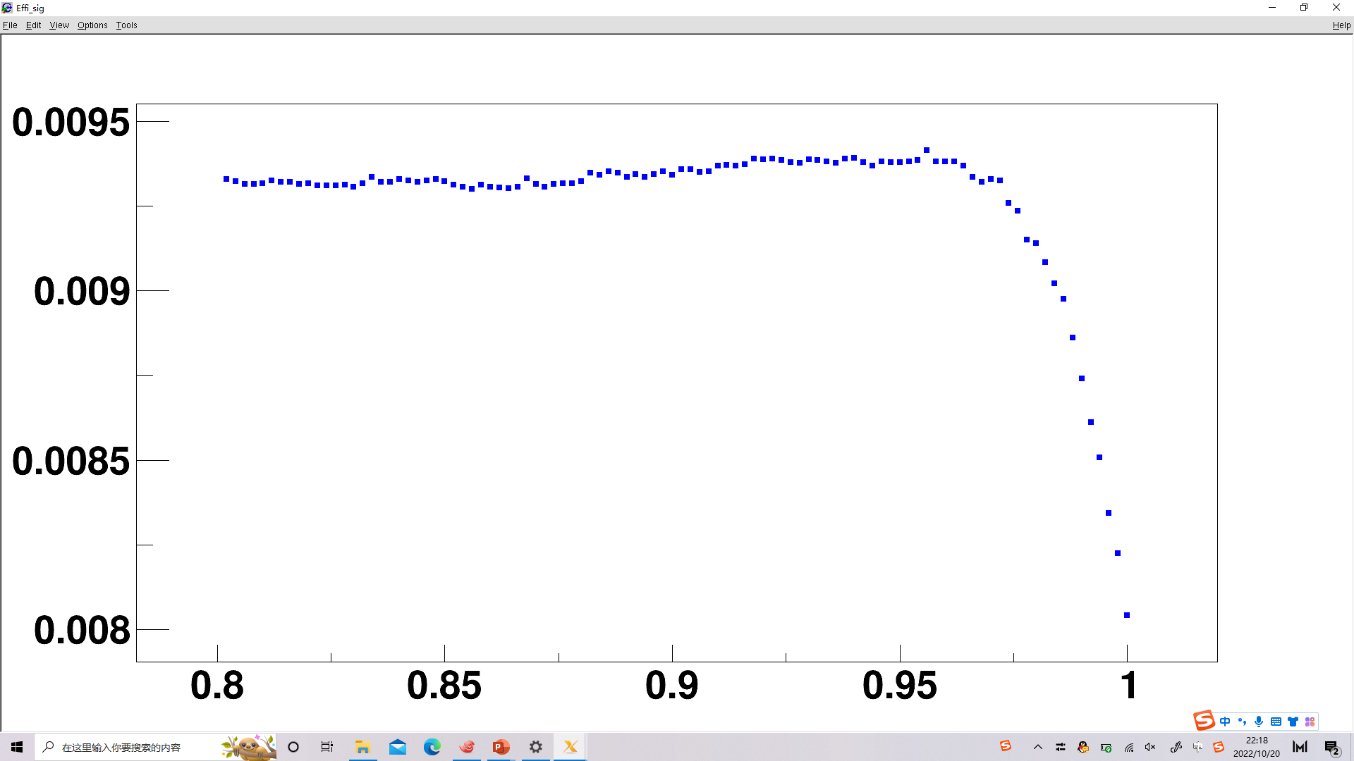
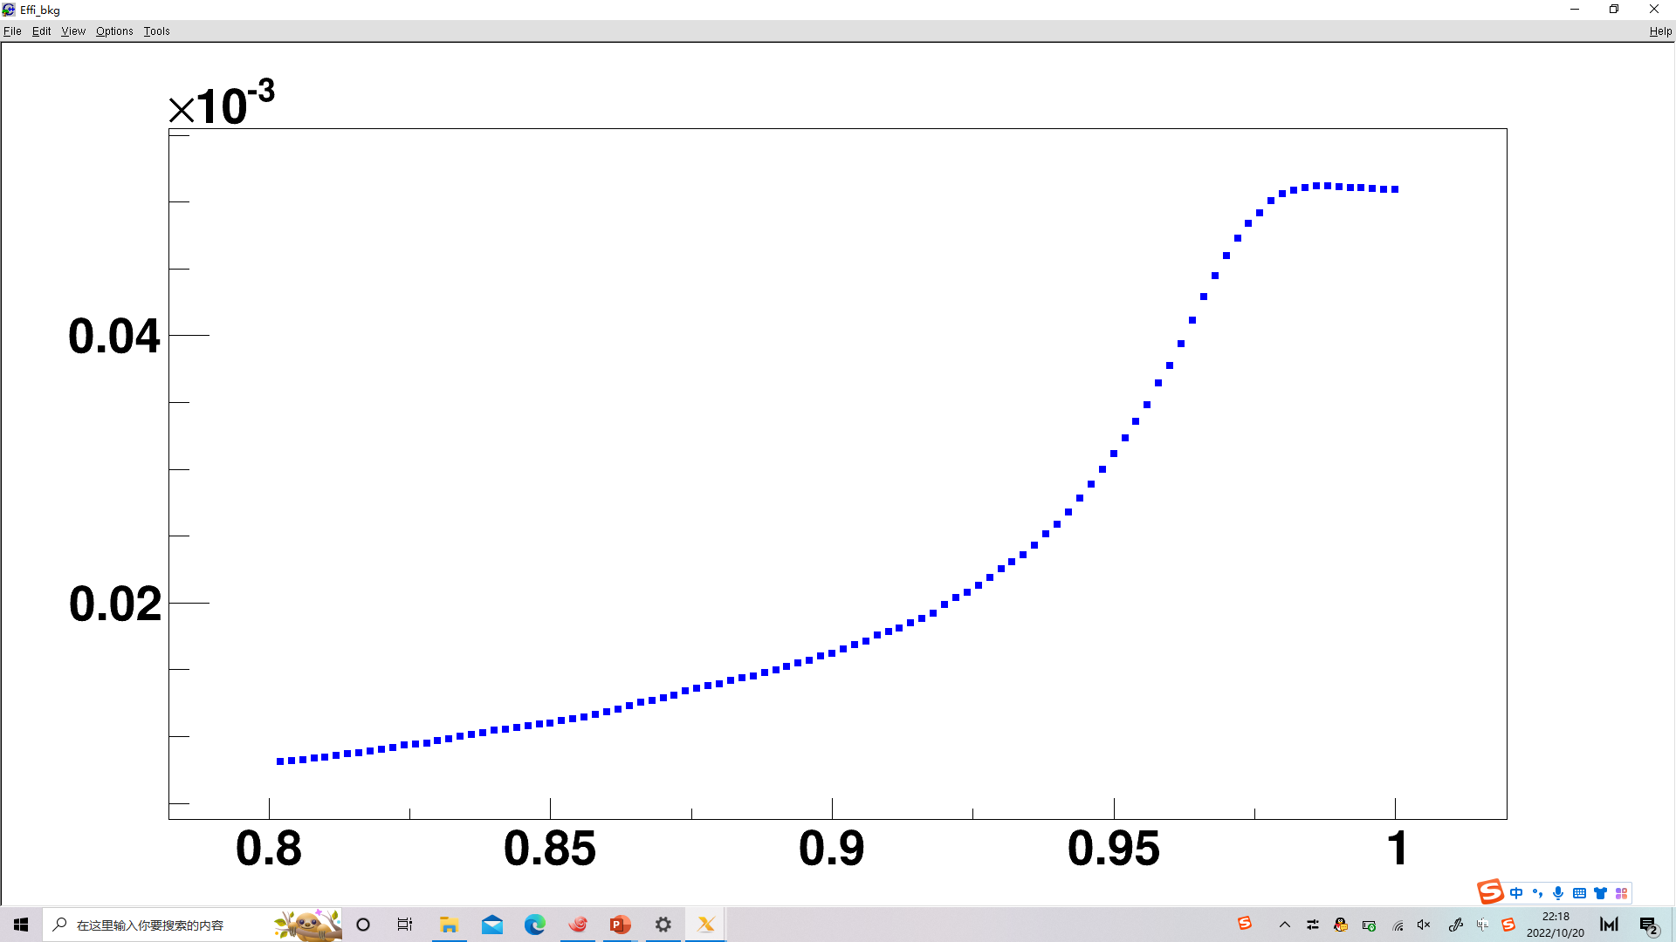
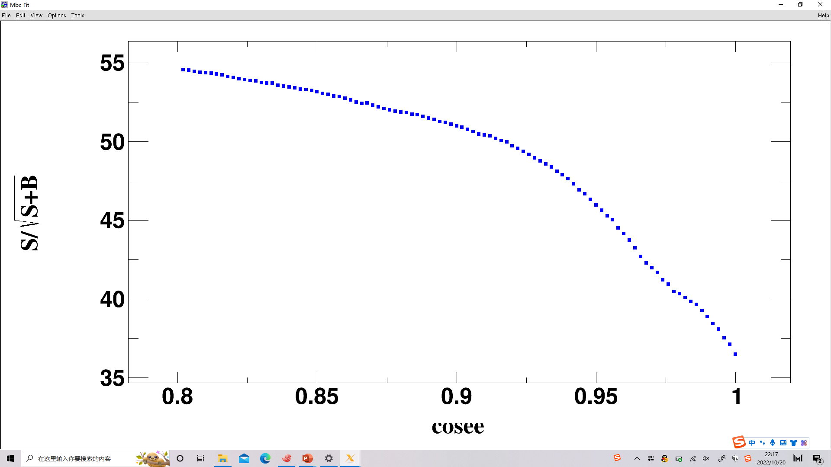
Check of angle between $e^{+}e^{−}$ in Conversion Package
We choose $R_{xy}, cosθ_{eg},Δ_{xy}$ information from gamma conversion package(GammaConv-00-00-03) when the angle between $e^{+}e^{−}$ is higher than a threshold, and those from the result of vertex fit with electron pair if lower. We choose MC of signal process and conversion process in equal propotion to PDG. When we change the threshold, $S/{\sqrt{S+B}}$, $ε_{signal}$ and $ε_{bkg}$ are shown below:
$$S/\sqrt{S+B}$$
$$ε_{signal}$$
$$ε_{bkg}$$

Slide 2
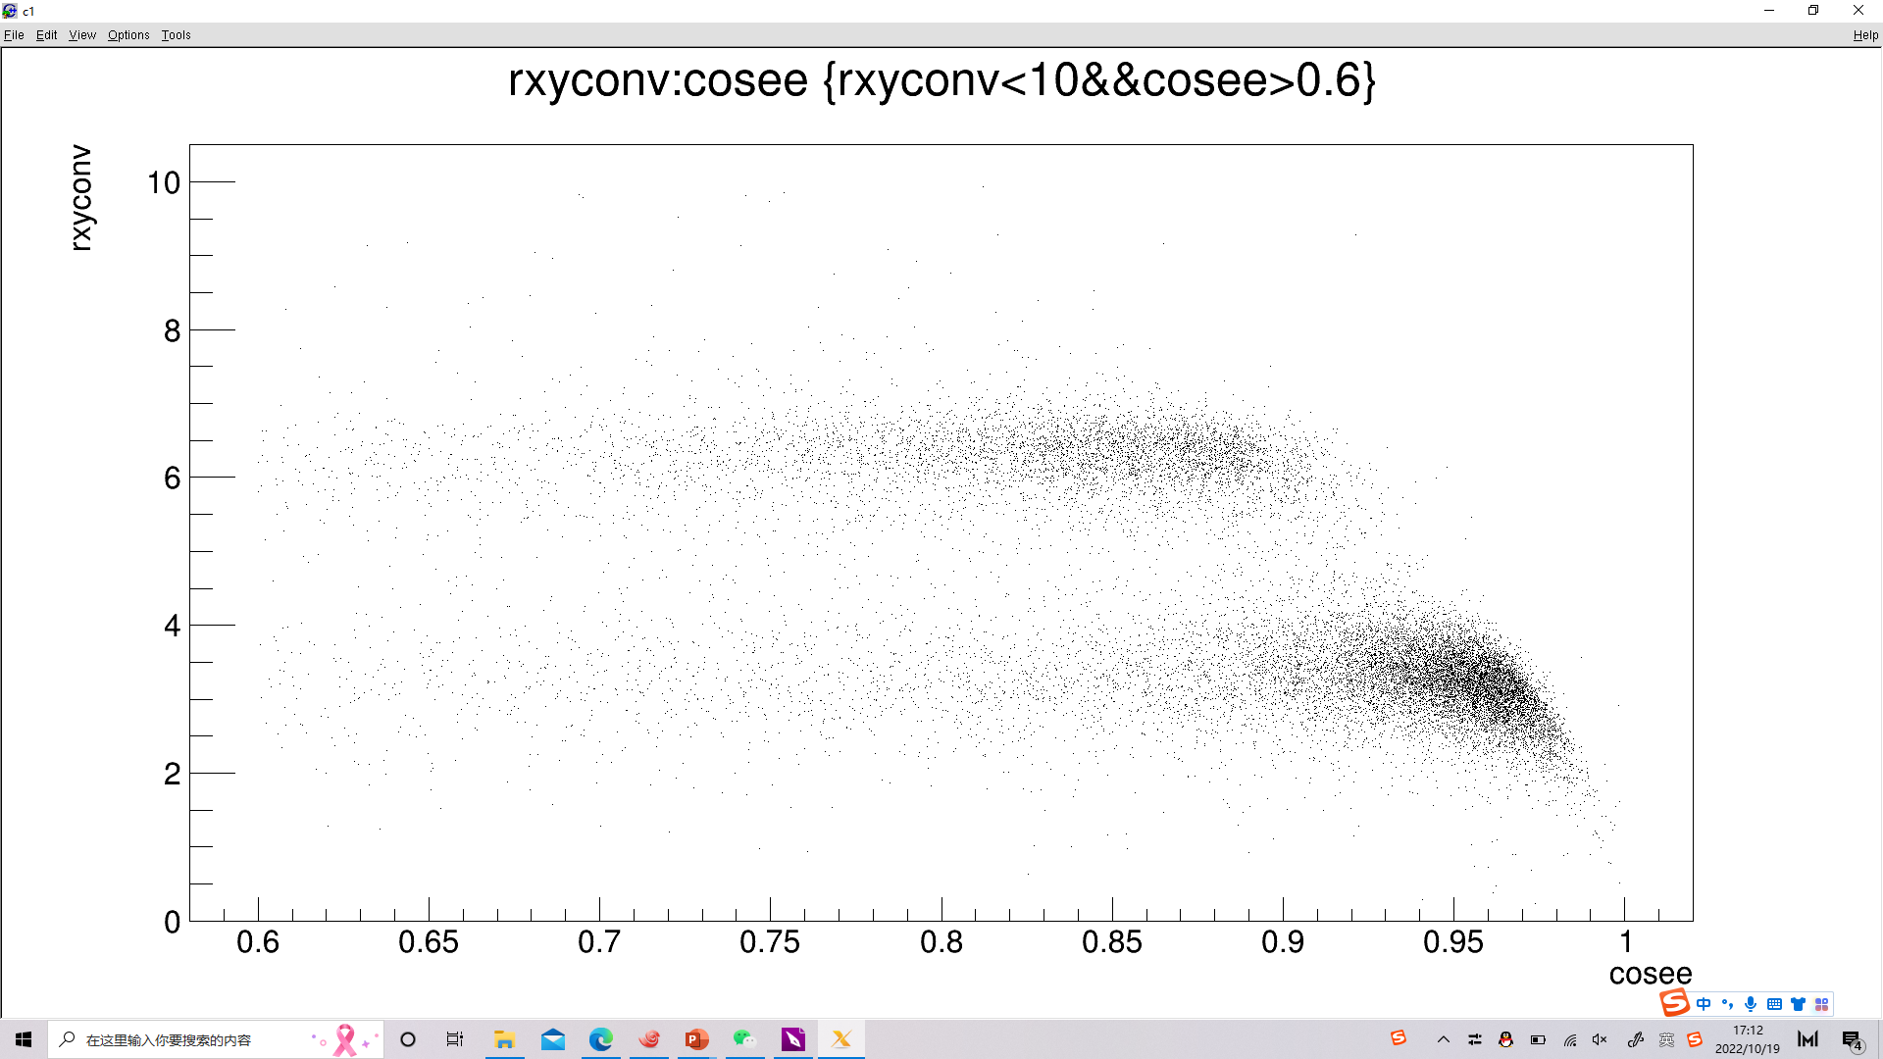
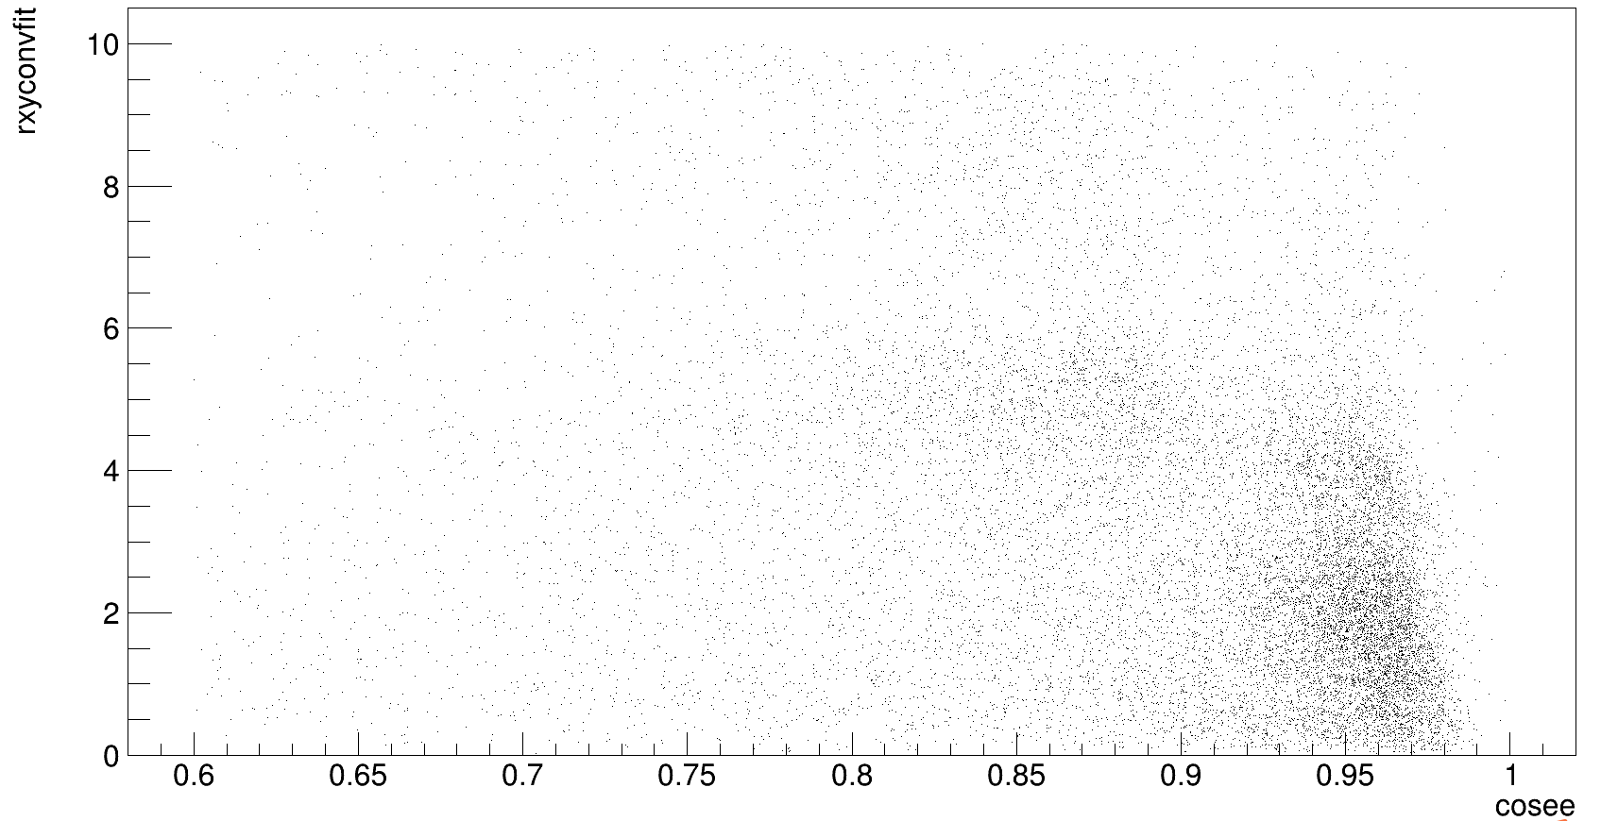
Distribution of rxyfit-cosee and rxy-cosee
We call rxy when cosee is higher than the threshold rxyconv(from conversion package) and else rxyconvfit(from vertex fit). The distribution of rxyconvfit-cosee and rxyconv-cosee in conversion process are listed below:

Slide 3
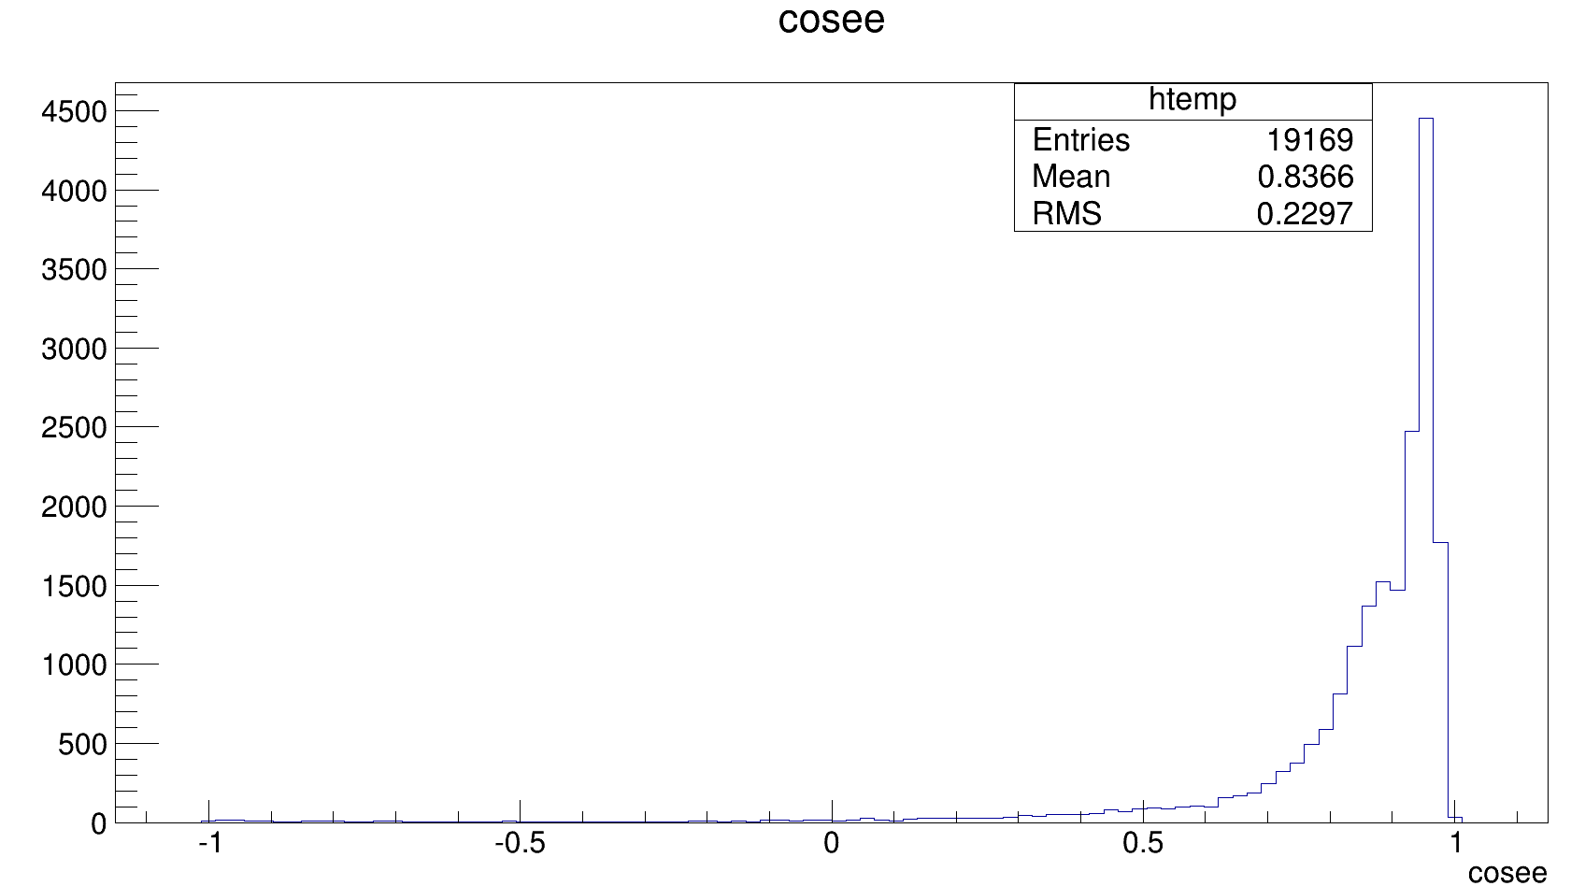
We can see that the number of rxyconv is very low when rxyconv<2, and rxyconvfit at a high level when rxyconv<2. So $ε_{bkg}$ mostly depends on the distribution of cosee. When the threshold mentioned above gets higher, $ε_{bkg}$ also gets higher, which is shown in Page 14. The distribution of cosee in conversion process is shown below:

Slide 4
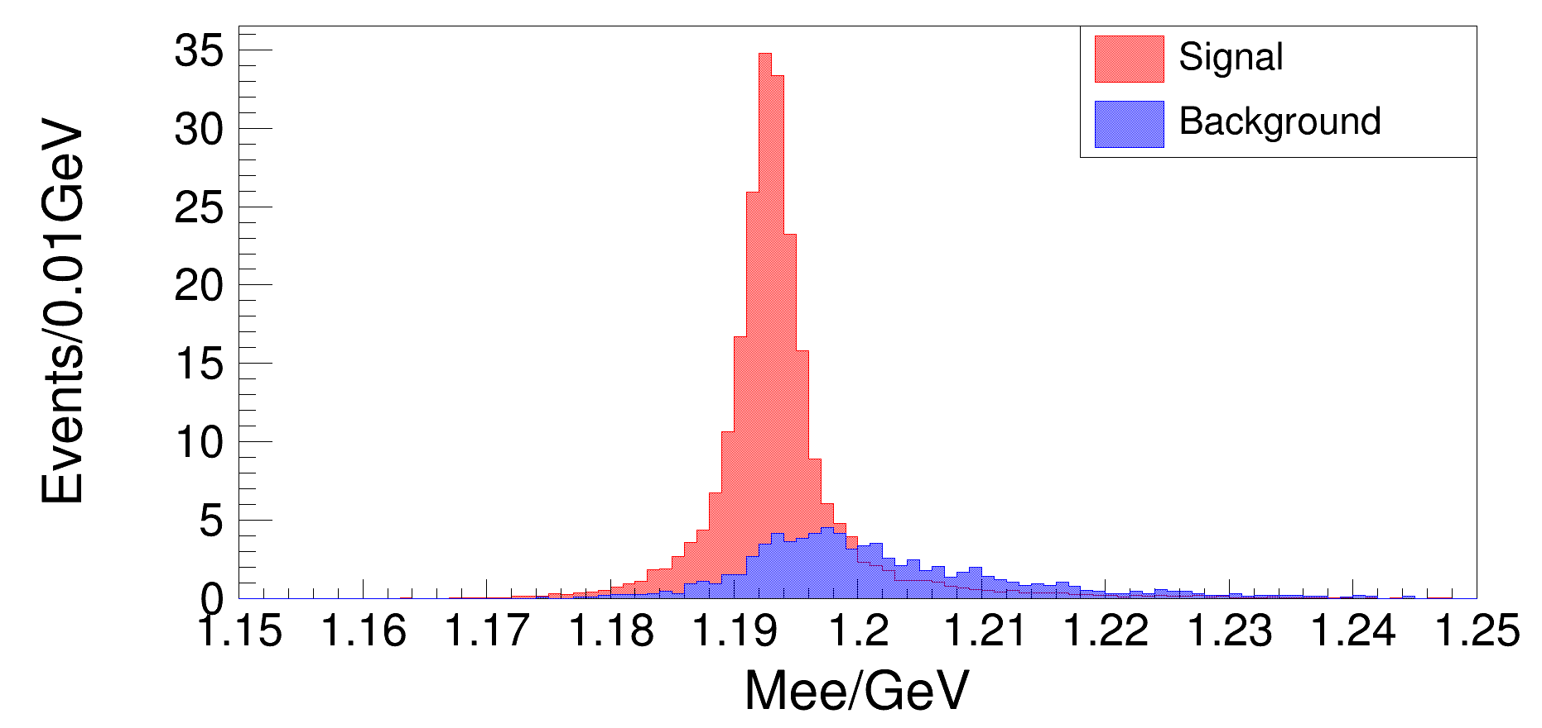
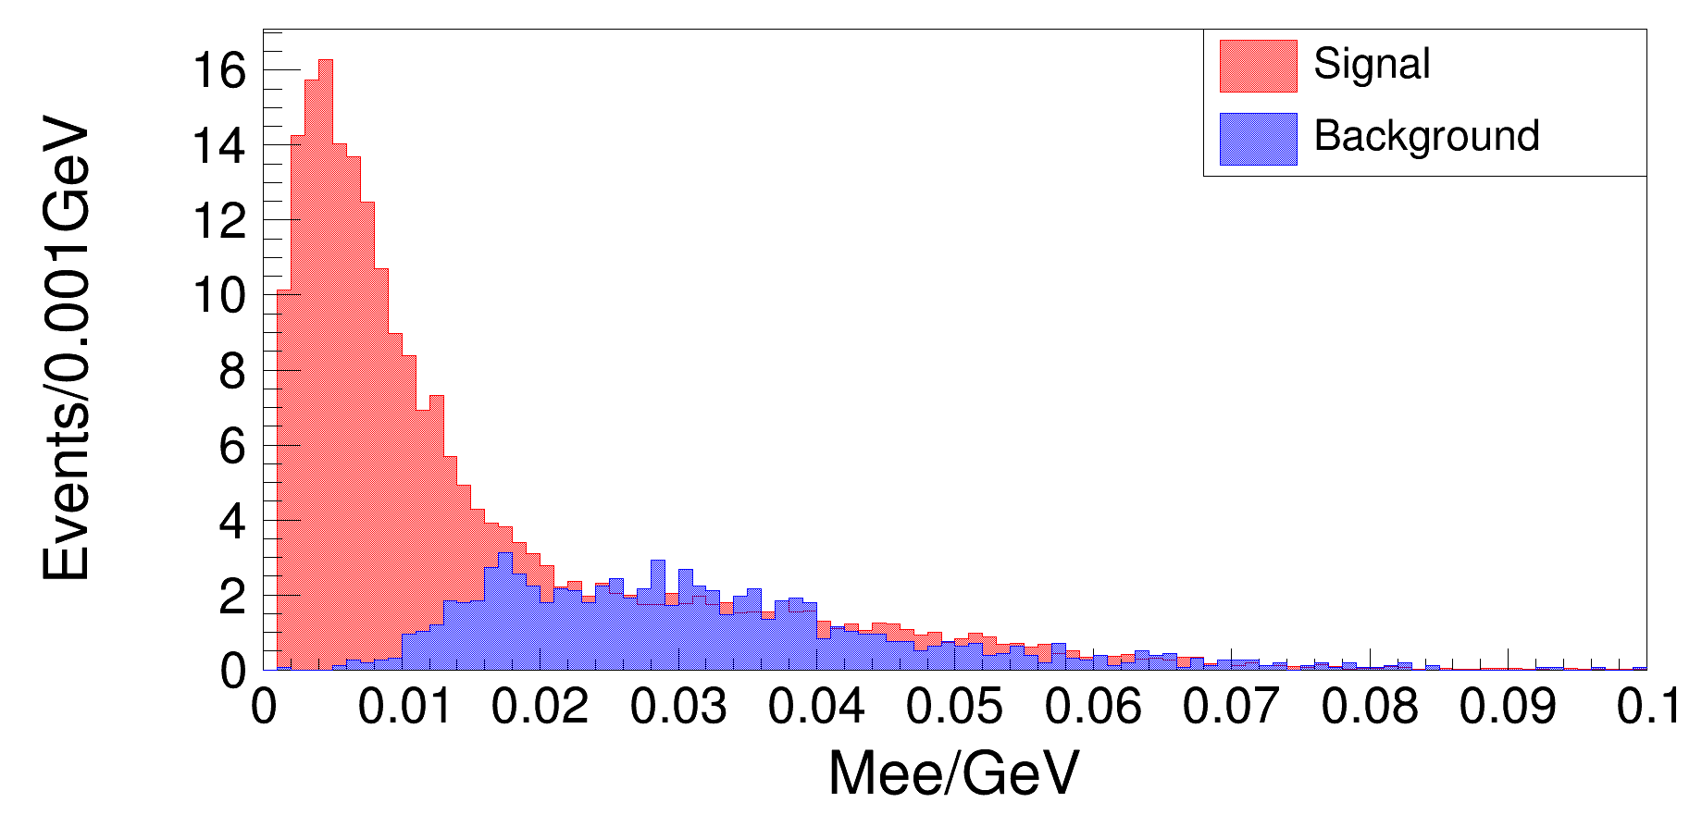
Selections in DT
ST part
$L_{\overline{p}π^{+}}>0$, ${ χ}_{\overline{p}π^{+}}^{2}<20$ , $\left|M_{\overline{p}π^{+}}−M_{Λ}^{PDG}\right|<0.008GeV/c^{2}$
$Δ_{m}=\left|M_{\overline{Λ}γ}−M_{\overline{p}π^{+}}+M_{Λ}^{PDG}−M_{Σ^{0}}^{PDG}\right|<0.015GeV/c^{2}$
$1.12GeV/c^{2}$ < $M_{\overline{Λ}γ}^{recoil}$ < $1.26GeV/c^{2}$
$θ_{γ}^{match}<5^{°}$
DT part
$L_{pπ^{−}}>0$, ${ χ}_{pπ^{−}}^{2}<20$ , $\left|M_{pπ^{−}}−M_{Λ}^{PDG}\right|<0.008GeV/c^{2}$
$1.17GeV/c^{2}{<M}_{Λee}$ $<1.23GeV/c^{2}$
$0<M_{ee}<0.1GeV/c^{2}$
$\left\{\begin{aligned}rxyconv<2 \cos_{ee}>0.9 \\ rxyconvfit<2 \cos_{ee}<0.9\end{aligned}\right.$

Slide 5
