Slide 1
The measurement of interaction between antiprotons in RHIC
Liucong

Slide 2
Introductions
The BNL and CERN provide the best high-energy heavy ion collider

Slide 3
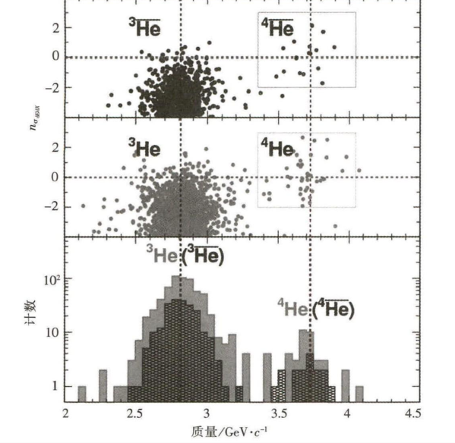
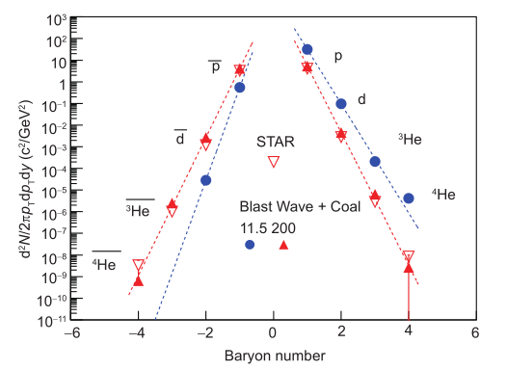
Motivation
Motivation:
■ Very suitable conditions for the study of nuclear antimatter atoms
■Tamount of antiproton produced by the collision between the center of the RHIC and the LHC collider is considerable
■ Investigate the Symmetry
■ The same amount of protons and antiprotons
■ For further study of the interaction between the more complex antimatter nucleus

Slide 4
Experiment devices
RHIC gold nucleus be accelerated to 100 GeV per nuclear energy
The STAR detector uses different detector elements to gather information after each nuclear collision

Slide 5
Experiment conditions
The colliding of two beams of gold nucleus imitates the big bang.
QGP produced.
When QGP rapidly cooled producing about the same amount of protons and antiprotons.
Polymerization process producing anti-nucleons usually takes place at the last phase of this environment.

Slide 6
Measurement
To explore the antiproton-antiproton interaction can be realized through the momentum correlation function, the correlation function of two particles is defined as the equation above.

Slide 7
Measurement
A(k*):
Stands for momentum correlation distribution of two particle pairs from a real collision
B(k*):
Stands for momentum correlation distribution of two particle pairs from different collisions.

Slide 8
Measurement
The Identification interval of the antiprotons is expanded from 1GeV to 3GeV
The sample of a clean dozen of antiprotons was collected when measuring the correlation function of two particles

Slide 9
Results
The correlation functions are similar in structure
The scattering length f and effective length d are similar to their counterparts

Slide 10
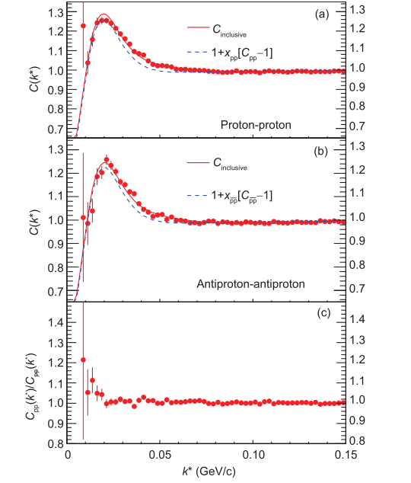
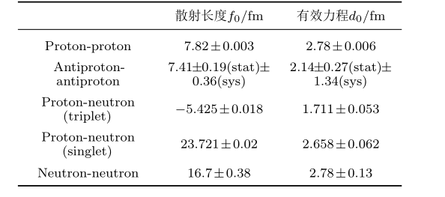
Summary
The interactions between two antiprotons are also attractive.
Basic function parameters are the same.

Slide 11
Result discussing
Many similarities between the antiproton-antiproton interactions and the proton-proton interactions.
Expecting to differences from the interaction between antiprotons .
The results also provide quantitative verification of the matter-antiparticle symmetries that promote nuclear and antinuclear bonding.
The study of antimatter is increasingly playing an important role.

