Slide 1
PWA of $e^{+}e^{−}$→$K^{+}K^{−}π^{0}π^{0}$
Weekly work report
Yateng Zhang
University of Science and Technology of China

Slide 2
Amplitude
$Φ$+anything
$$Φσ$$
$$Φf_{0}(980)$$
$$Φf_{0}(1370)$$
$$Φf_{2}(1270)$$
$$Φπ^{0}π^{0}$$
$$Φ(1600)π^{0}$$
R($π^{0}π^{0}$)+$K^{+}K^{−}$
$$K^{+}K^{−}f_{0}(980)$$
$$K^{+}K^{−}σ$$
$$K^{+}K^{−}f_{0}\left(1370\right)$$
$$K^{+}K^{−}f_{2}(1270)$$
$$K^{∗+}K^{∗−}$$
$$K^{∗±}K^{∓}π^{0}$$
$$K^{∗}\left(1410\right)K$$
$$K_{1}^{}\left(1400\right)K$$
$K_{1}^{}\left(1270\right)K$ ${(K}_{1}^{}\left(1270\right)$->$K^{∗}(892)π$
$K_{1}^{}\left(1270\right)K$ ($K_{1}^{}\left(1270\right)$->$K^{∗}(1430)π$)
$$K^{∗+}0(1430)K^{∗−}$$
$K^{∗+}2(1430)K^{∗−}$ ( |23> |43> )
$K_{}^{∗}2$K ($K_{}^{∗}2$-> $K^{∗}π^{0}$)
$$K^{∗±}2K^{∓}π^{0}$$
$$K^{∗±}0K^{∓}π^{0}$$
PHSP
$$K^{+}K^{−}π^{0}π^{0}$$
Phi mass window region:
|M(KpKm)-1.02|<0.02 GeV

Slide 3
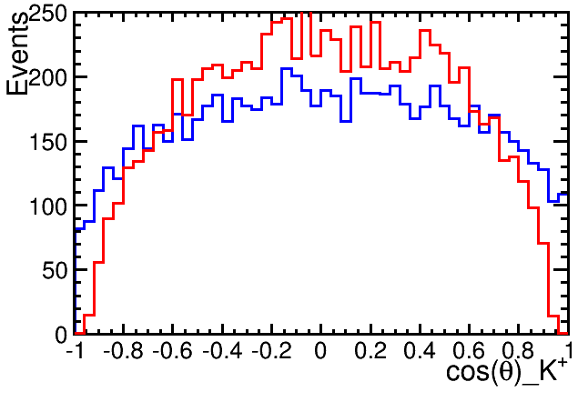
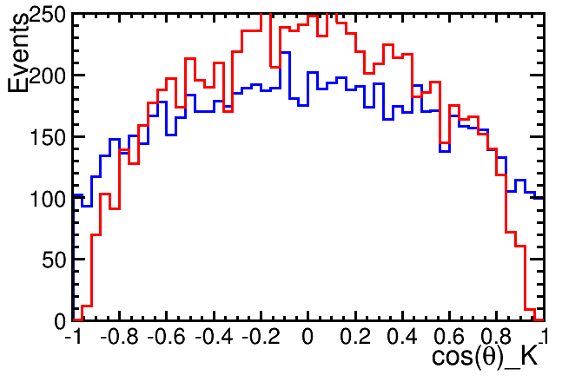
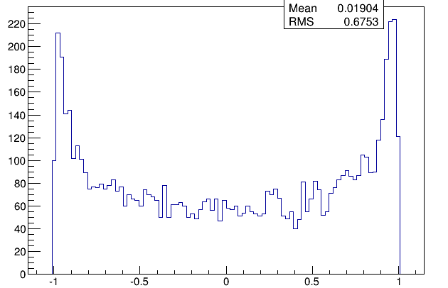
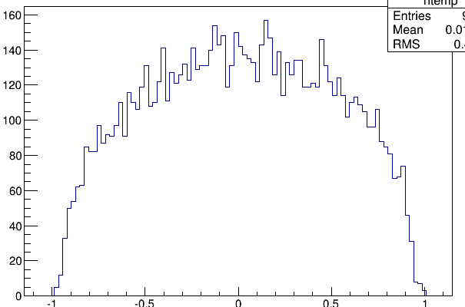
Blue 1C
Red 6C
2 tracks
Missing track

Slide 4
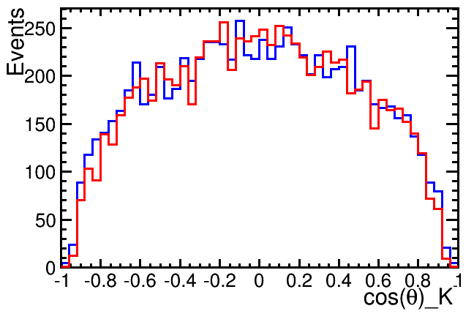
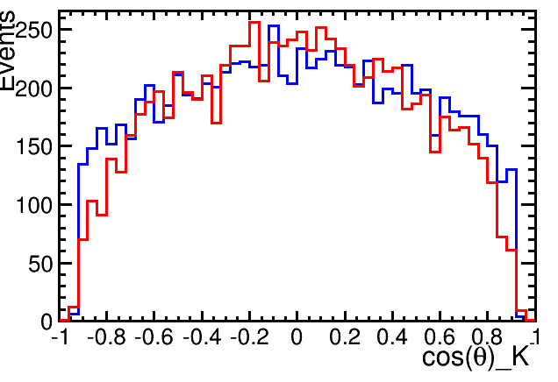
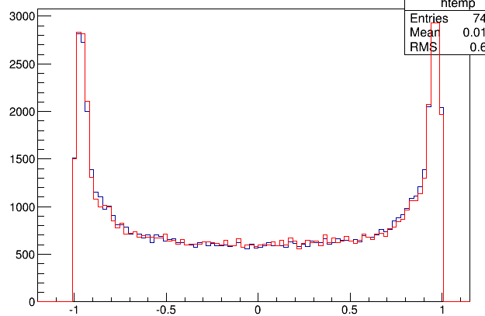
nGood ==2, 1C and 6C
Misstrack angle <0.92

Slide 5
Coskp <0.8 CosKm <0.8
Region 1
Coskp >0.8|| CosKm >0.8
Region 2

Slide 6
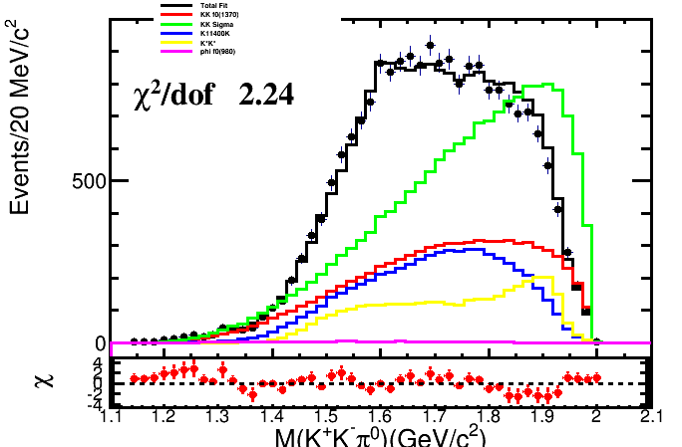
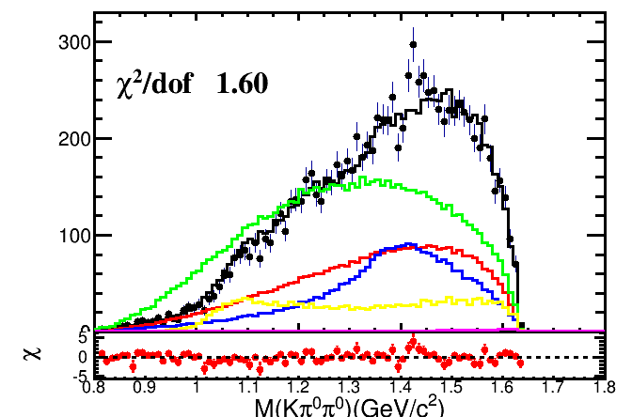
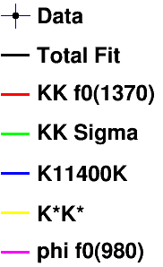
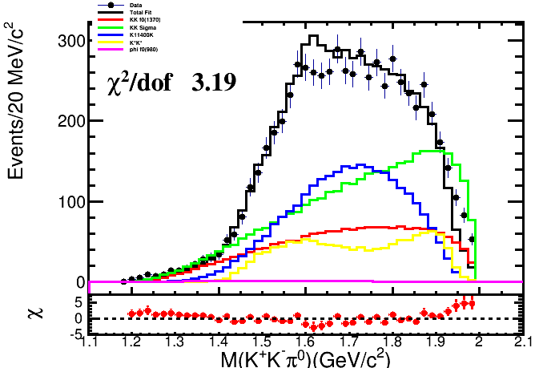
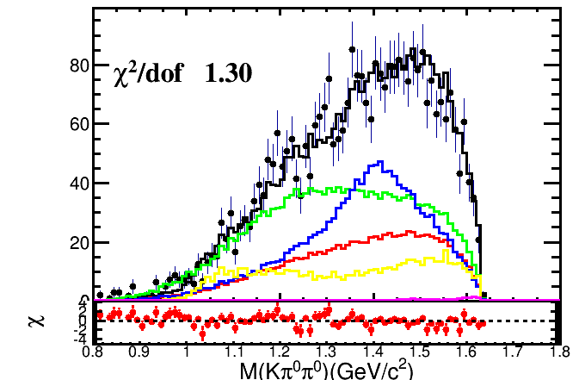
1C data
1C fitting result

Slide 7
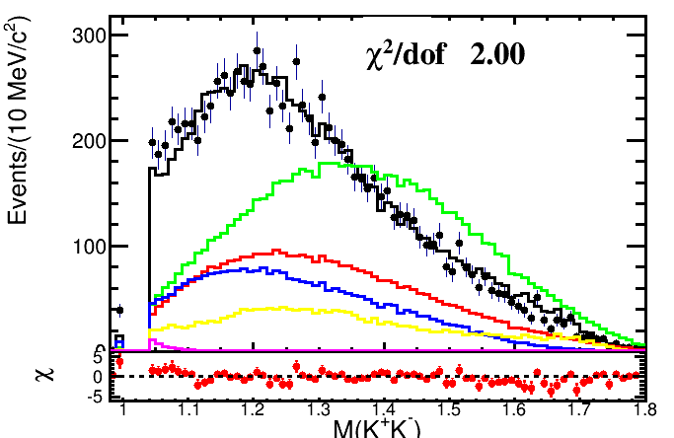
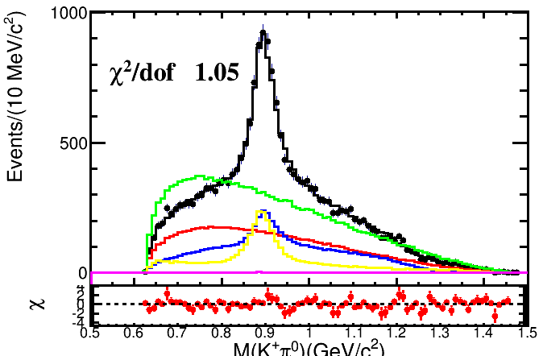
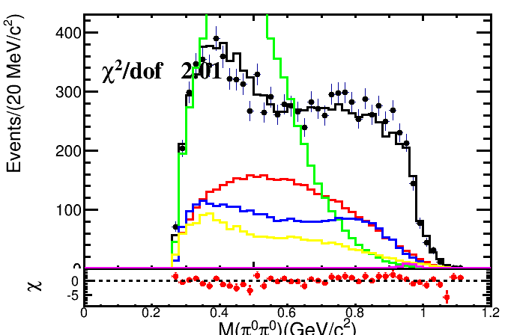
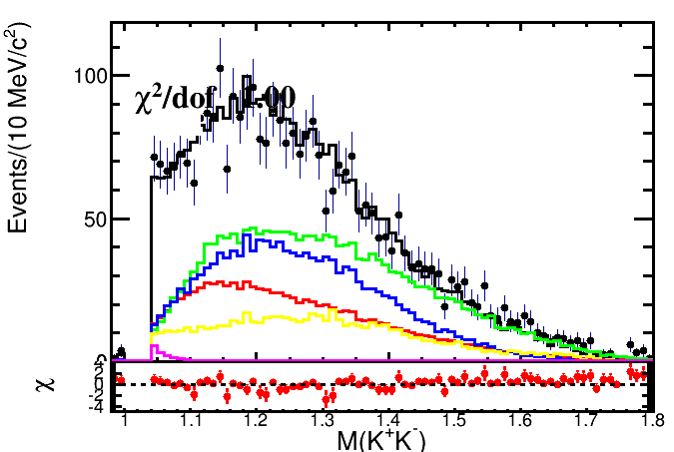
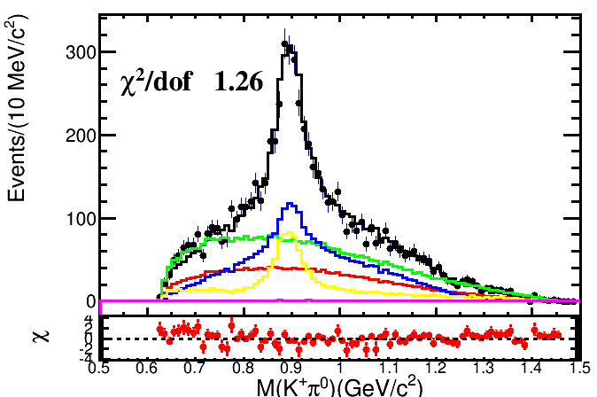
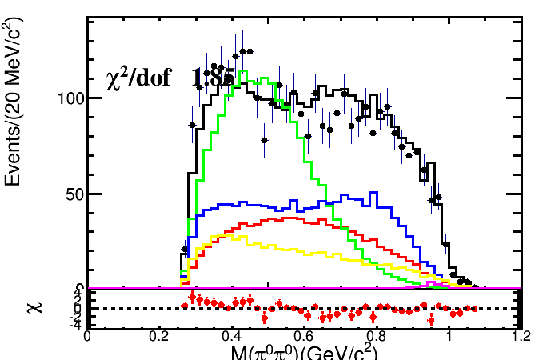
1C data
1C fitting result

Slide 8
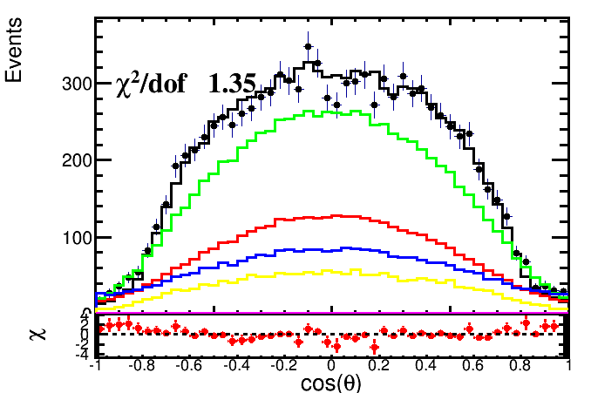
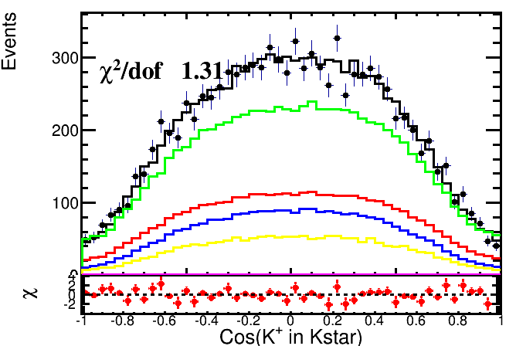
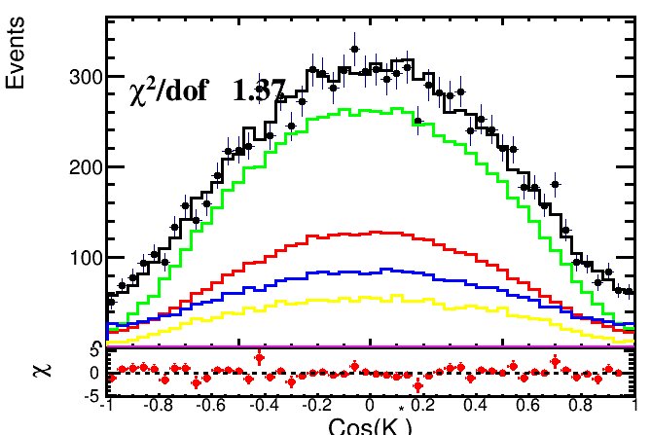
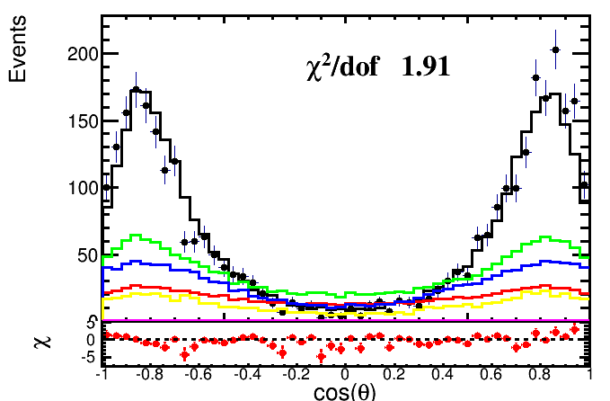
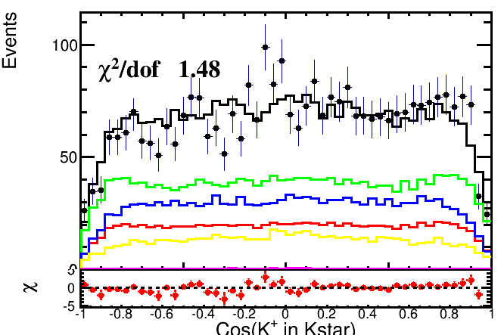
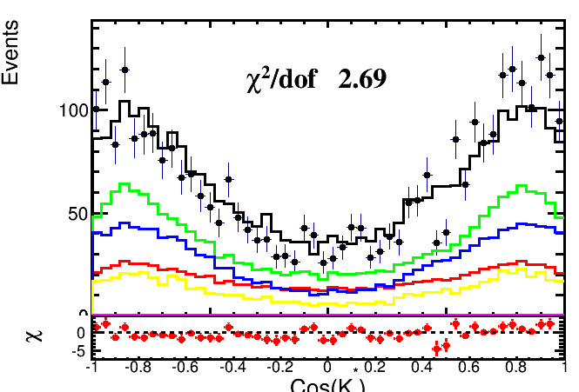
1C data
1C fitting result

Slide 9
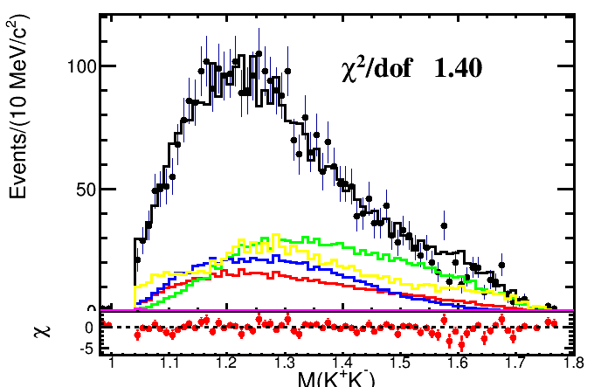
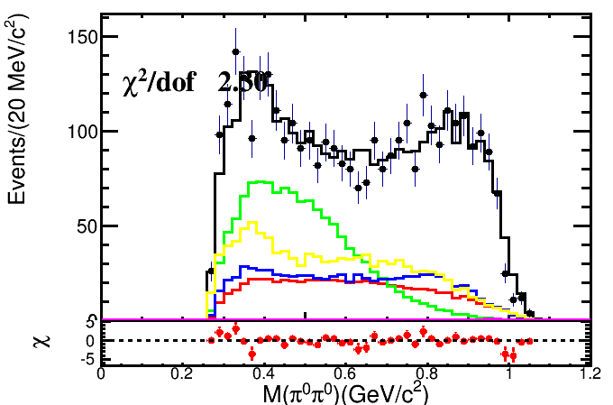
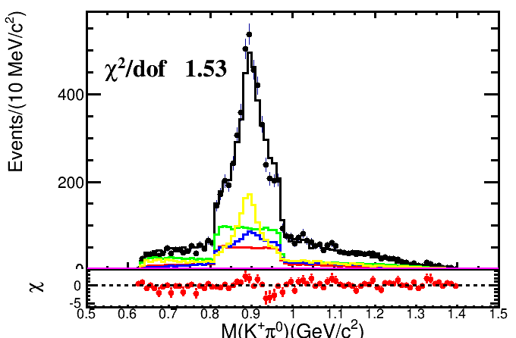
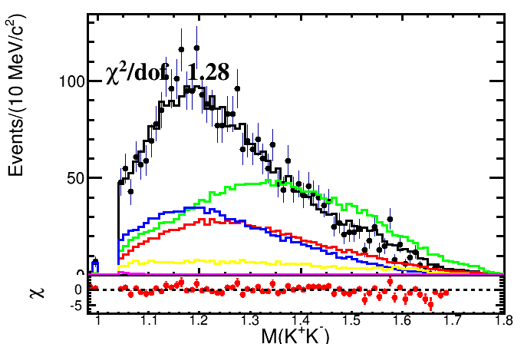
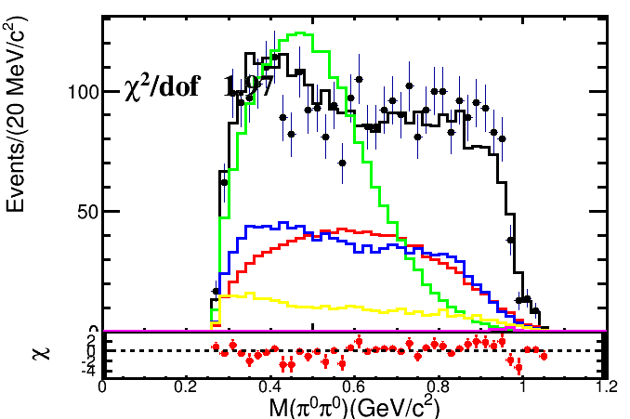
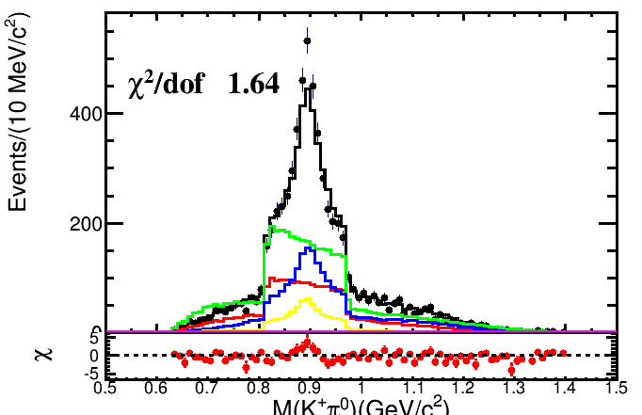
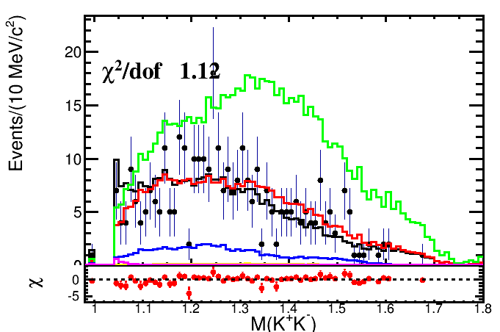
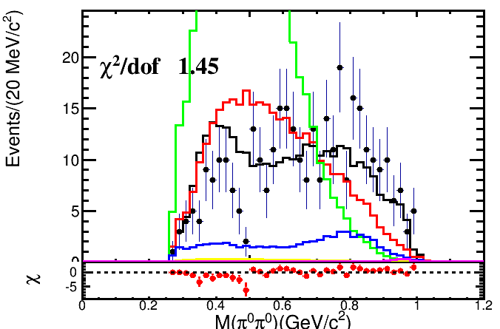
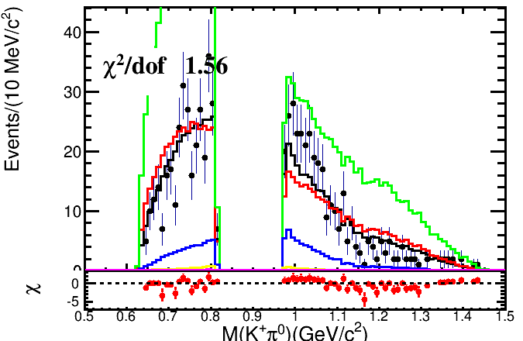
6C data
1C fitting result
Region 1
Region 2
Region 3

Slide 10
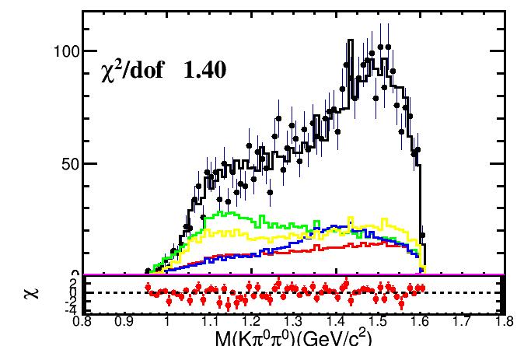
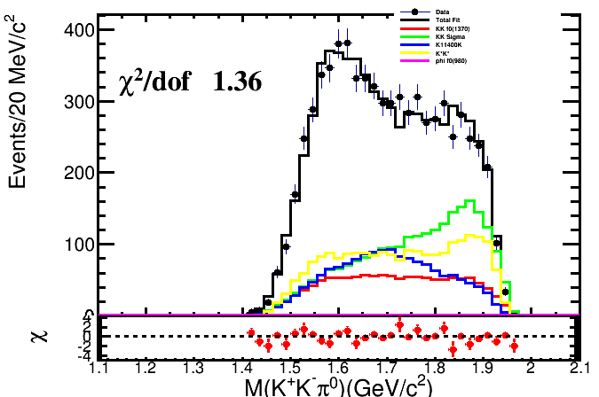
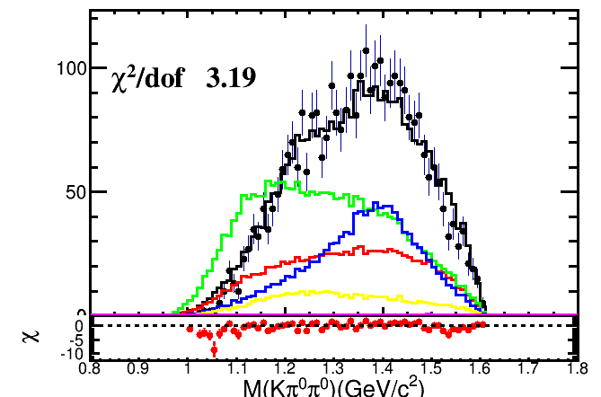
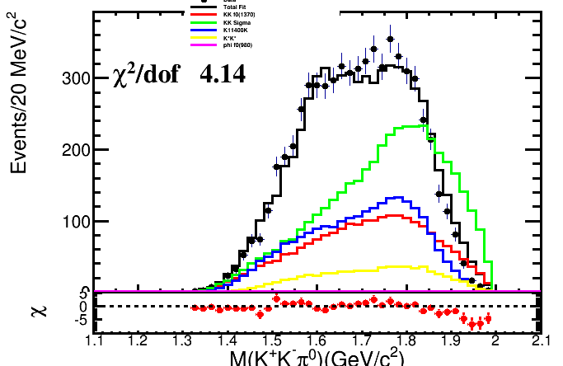
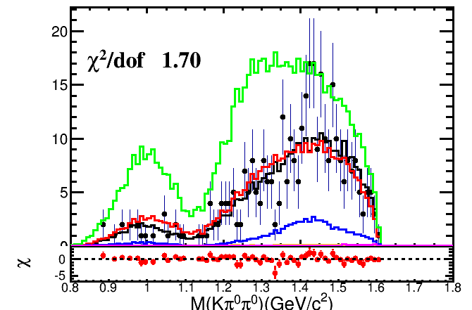
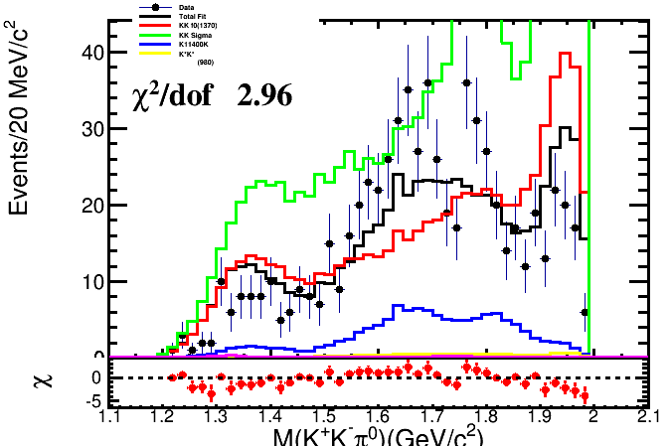
6C data
1C fitting result
Region 1
Region 2
Region 3

Slide 11
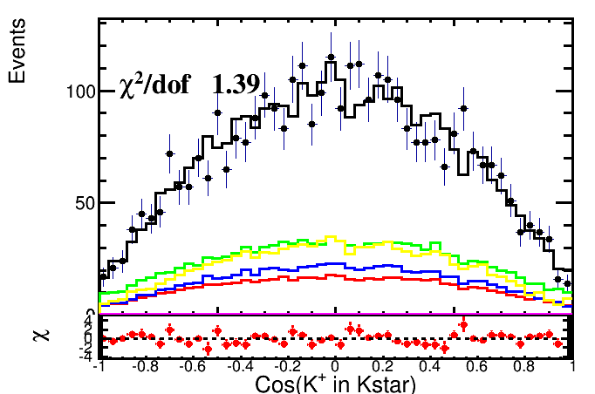
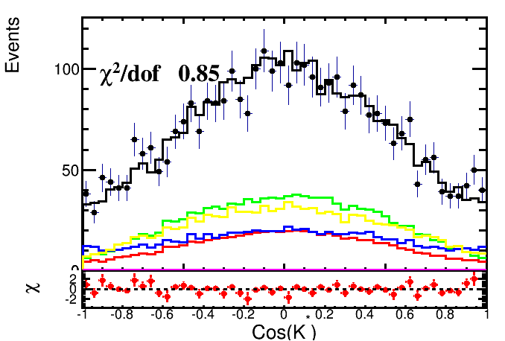
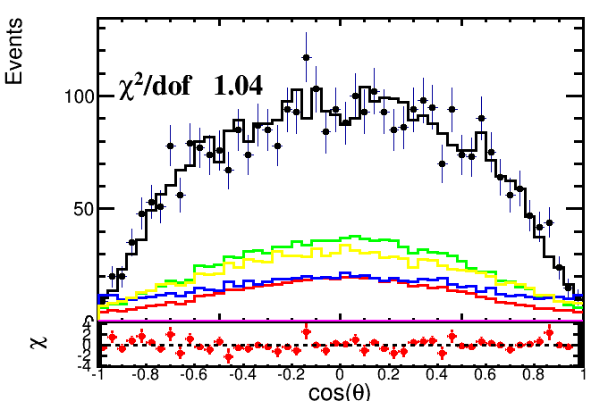
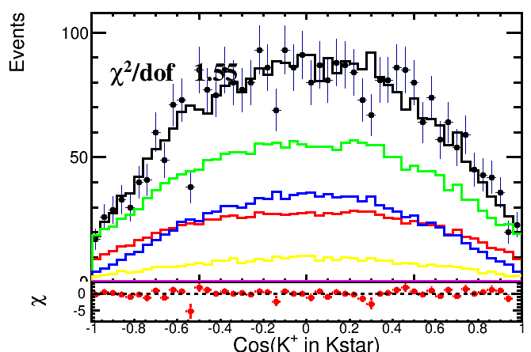
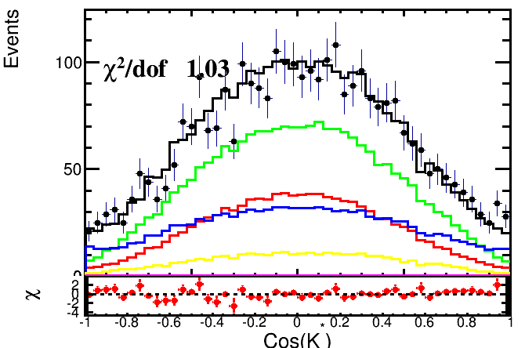
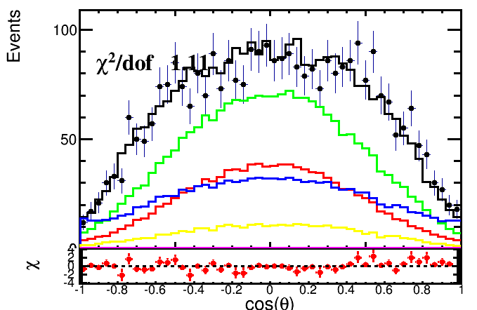
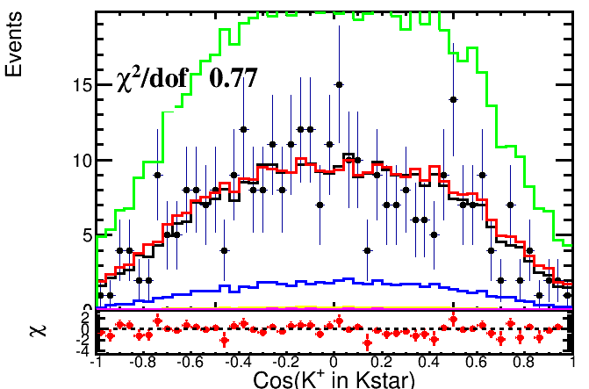
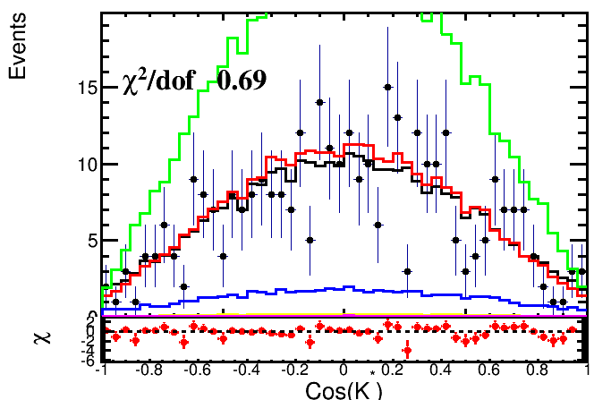
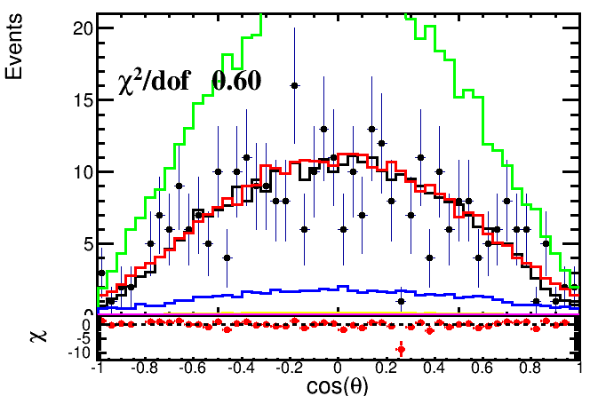
6C data
1C fitting result
Region 1
Region 2
Region 3

Slide 13
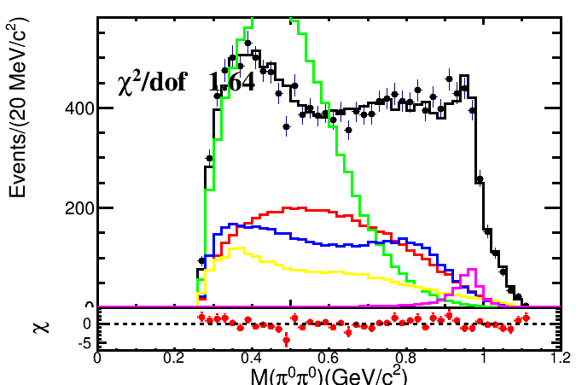
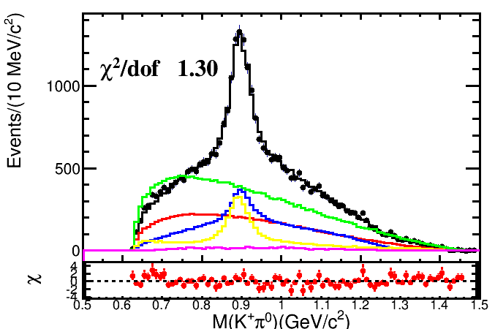
Remove Background contribution

Slide 15
K in KK

Slide 16
4Cdata Fitting result
6C data
6C fitting result

Slide 17
4Cdata Fitting result
6C data
6C fitting result

Slide 18
4Cdata Fitting result
6C data
6C fitting result

