Slide 1
Study of D→3Pi+X
zhouxk

Slide 2
motivation
As important background input for LHCb experiment of testing lepton flavour universality (B→Dlv)
Also can be used to search direct CPV

Slide 3
Tag mode
BOSS6.6.4.p02
6 golden modes for tag side:
Kpipi,Kpipipi0,Kspi,Kspipi0,Kspipipi,Kkpi
Cocktail inclusive MC

Slide 4
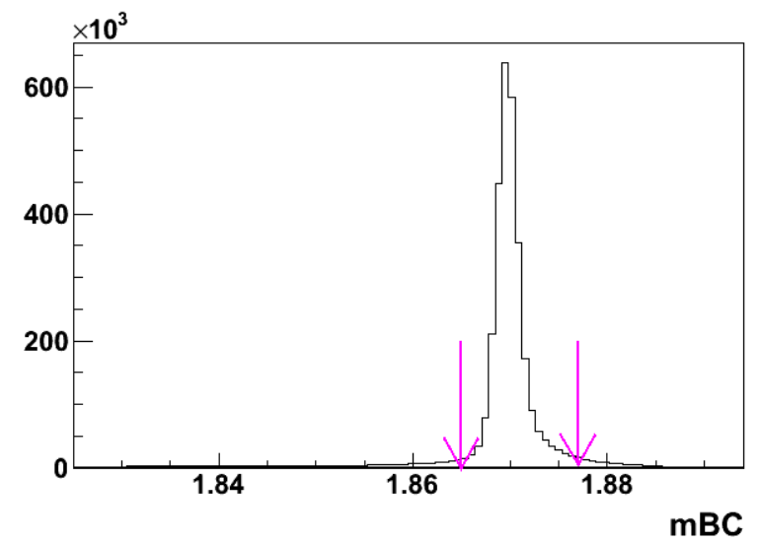
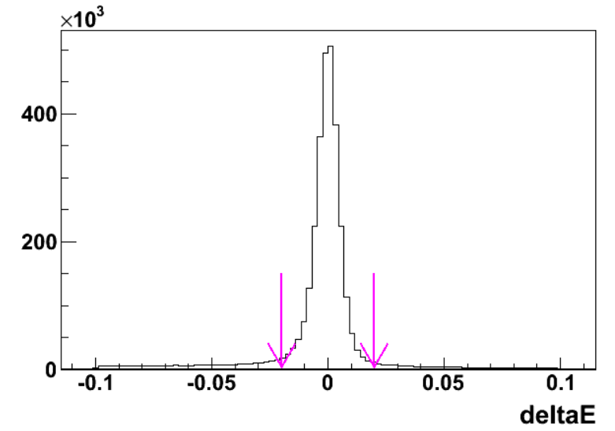
KPiPi study
Only Dp inclusive sample
1.865<mBC<1.8775
-0.02<deltaE<0.02

Slide 5
Signal side
PID:
Prob(Pi)>Prob(K) && Prob(Pi)>Prob(mu) && Prob(Pi)>0.001
E/p<0.6
Loop all the combinations
Defined D+→Pi+(1)Pi+(2)Pi-(3)…

Slide 6
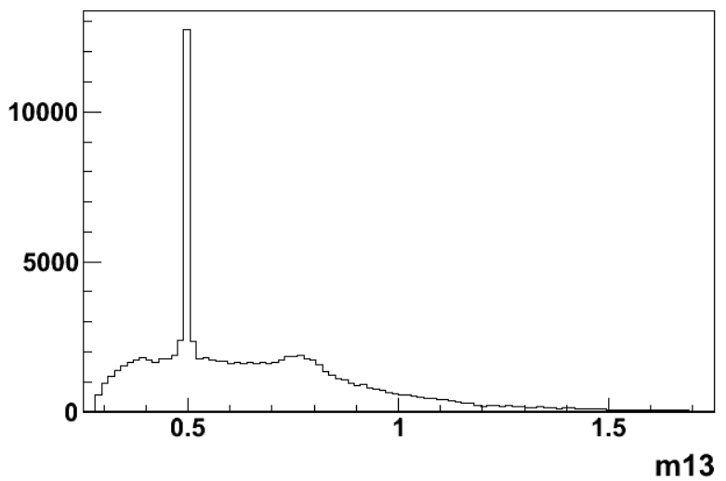
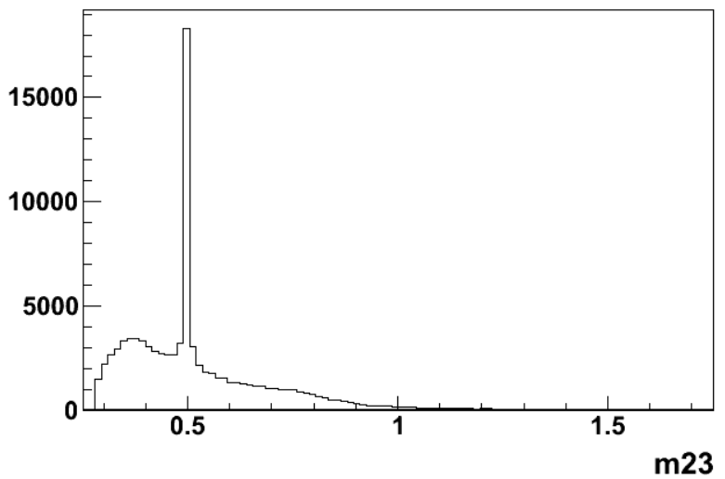
Quick view
Ks
rho
Cut Ks mass window [0.487,0.511]

Slide 7
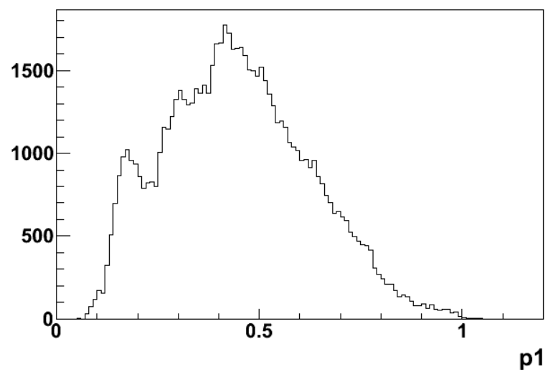
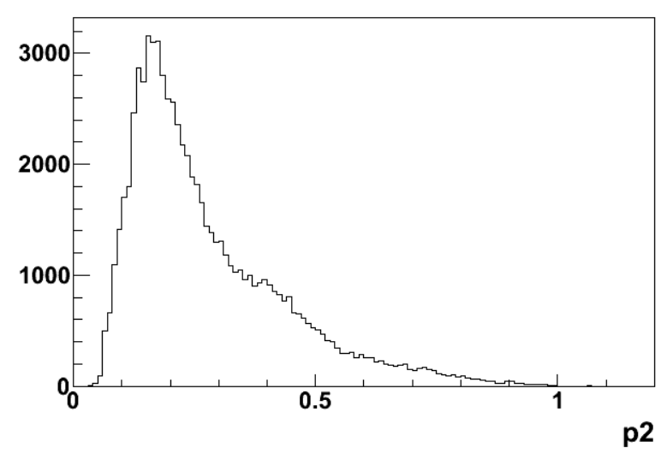
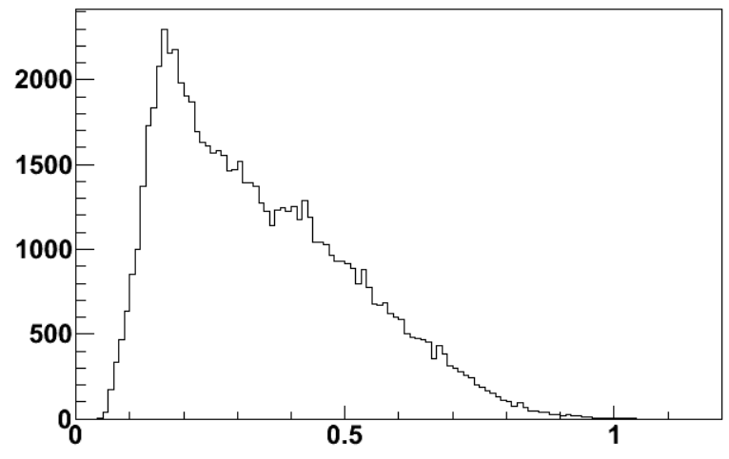
momentum

Slide 8
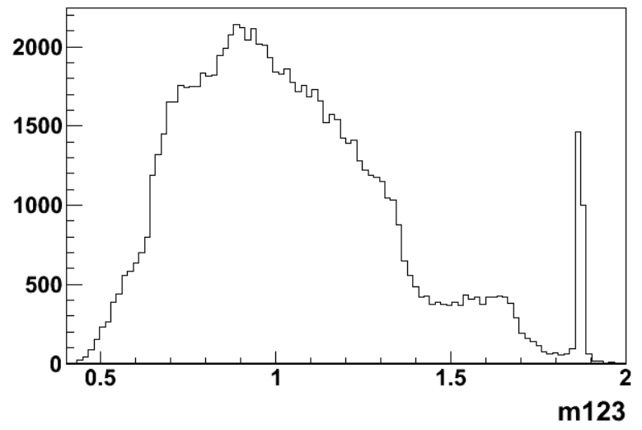
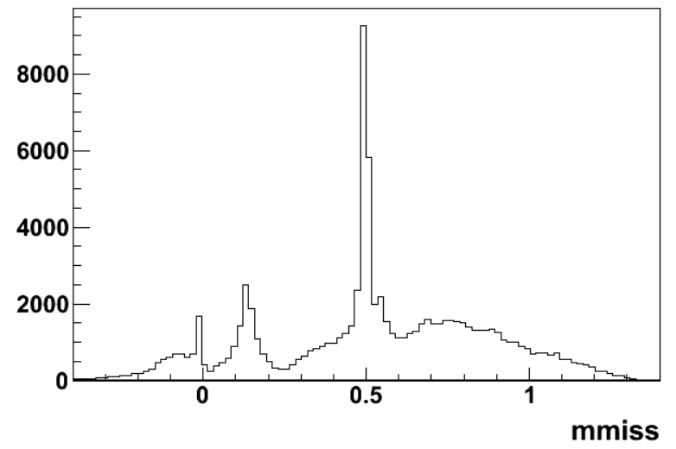
D→3piKs
D→3pi
D→3pipi0
D→3pieta
D→3pi

Slide 9
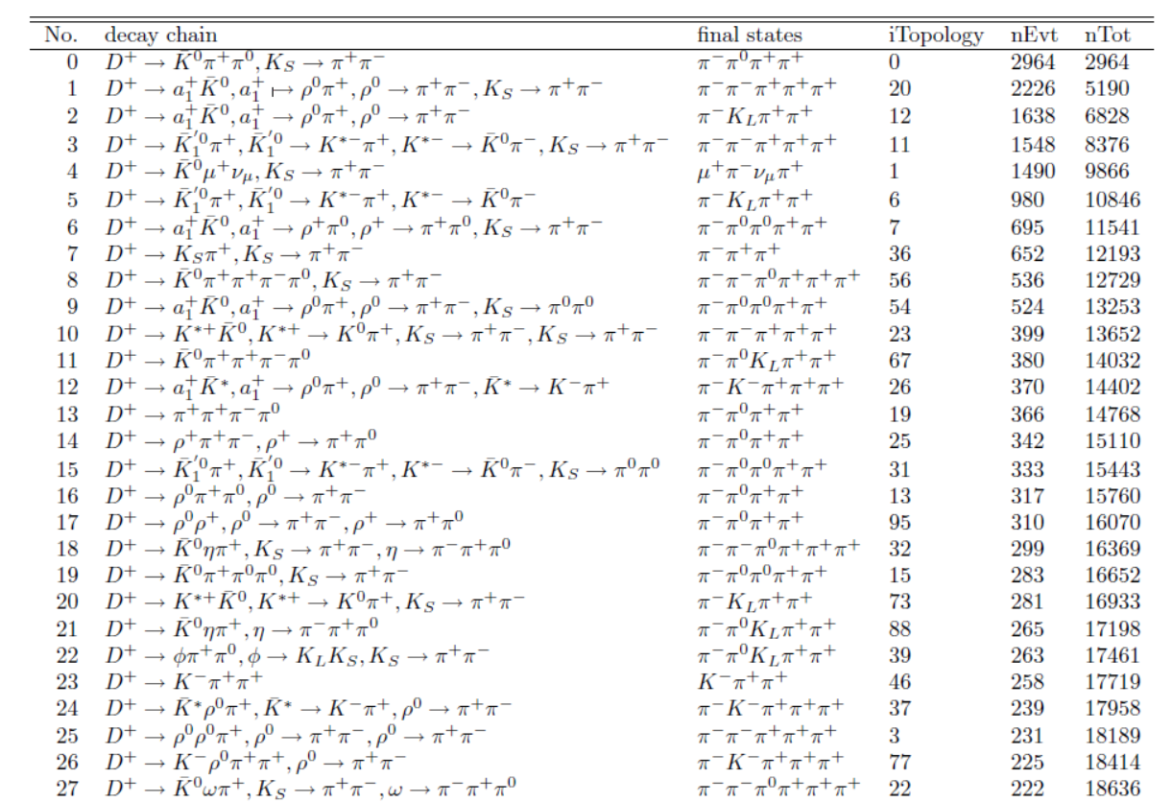
topology

Slide 10
5pi (3piKs,3pirho,KsKspi,rhorhopi….)
3pipi0 (Kspipi0,3pipi0,etapi,phipi…)
3piKL
3pipi0pi0 (Kspipi0pi0,phipipi0,3piKs)
pipimunu (Ksmunu,rhomunu)
5pipi0 (Kspipipipi0,Ksetapi,Ksomegapi,KsKspipi0….)
3piKLpi0
4piK
3pi
3pi3pi0
2pipi0munu
…

Slide 11
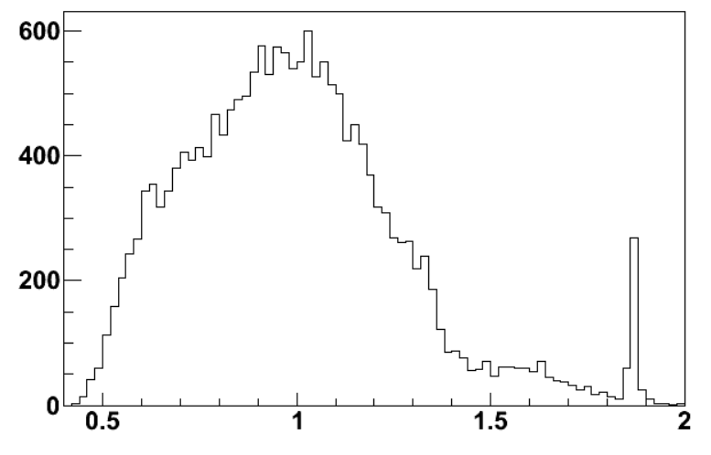
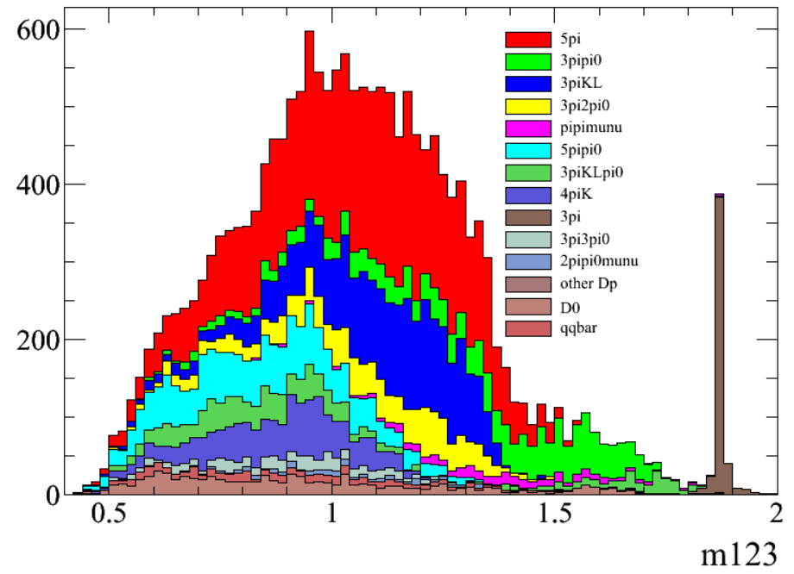

Slide 12
