Slide 1
Weekly report

Slide 2
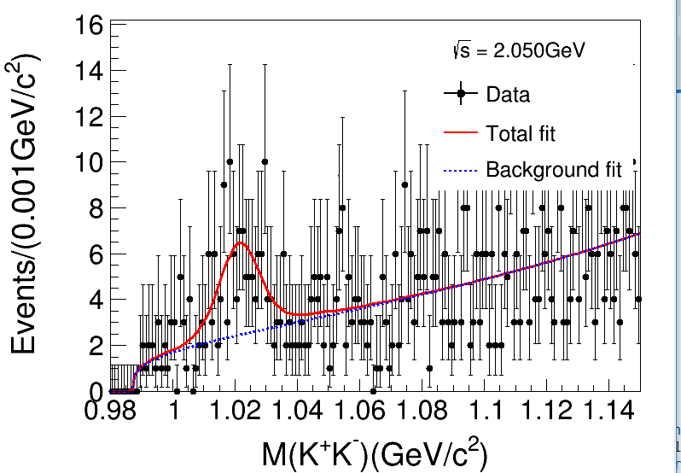
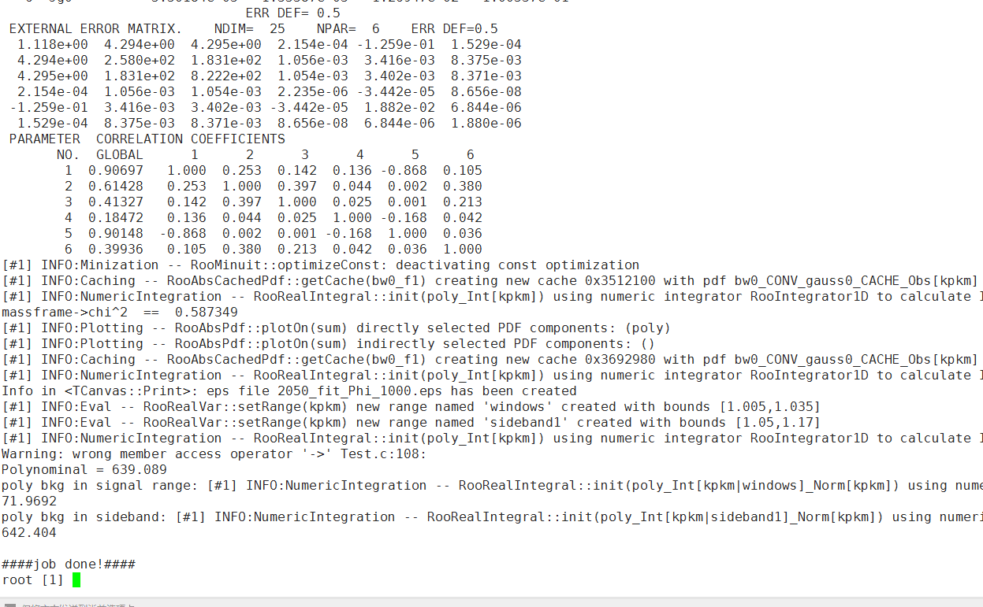
Poly bkg in signal range/ Poly bkg in sideband: 信号下本底和边带本底的比例，用来标定卡方图中本底贡献的Scale：
/besfs/users/tanyx/Run665p01_tanyx/Y2175/PhiPiPiAlg/Analysis/2125/Chisq_2125_Data_MC_PhiPiPi.cxx
文件中hchisq_4c_Side->Scale(0.169);（52行）
此处Poly bkg in signal range/ Poly bkg in sideband=0.169

Slide 3
自动化
/besfs/users/wangwp/Lambdac/boss/Lambdac/Fit/Modified_Realdata_fit/mbc_fit/FVersionX/FixedPara/SkimEvtNo/4600_fit_mbc
realdata_mode1_fit.cxx
cpp_HeadFile.sh
whole_mv.sh
看自动更改程序的脚本是怎么实现的，对相似操作多的工作提速很大

Slide 4
/workfs/bes/gaoxl/workarea-6.6.5.p01/OmegaetaAlg/OmegaetaAlg-00-00-01/src/Omegaeta.cxx
232——234行
m_run = eventHeader->runNumber();
m_rec = eventHeader->eventNumber();
m_evttag=eventHeader->eventTag();
在code中把事例编号存出，每个事例有对应的eventNumber，可以对单个event进行处理。

Slide 5
Event selectiono（4C）
Good Charged Track:
|Vz| < 10.0 && |Vr|< 1.0 && |cosθ|<=0.93;
NGood = 4 && NCharge=0;
PID:
N(π+)=N(π-) = 1; prob_π >prob_K && prob_π >prob_p;
N(K+)=N(K-) = 1; prob_K>prob_p && prob_K>prob_π;
Vertex fit (K+K-π+π-).
4C kinematic fit (K+K- π+π+).
χ21C(K+K- π+π+) < 20;

Slide 6
setup BOSS environment on lxslc
1. BOSS665p01.
2.R-scan data sets:
2014/12/31
2015
2175MeV

Slide 7
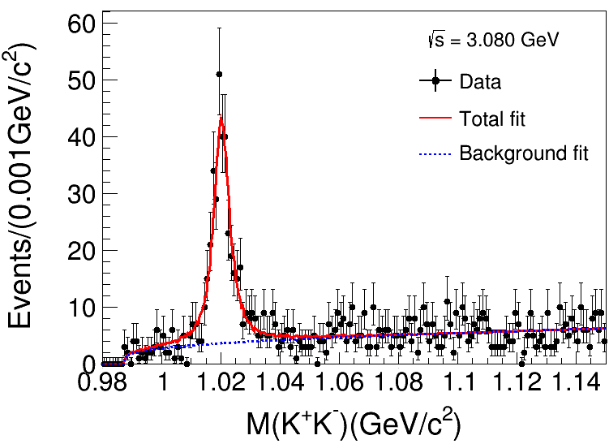
Lxslc6 @3080MeV：L=123.0pb⁻¹
Event
X²_{4C}(K+K-π+ π- ):3080MeV
(1) X²_{4C}(K+K-π+ π- )<20;
(2) ϕ(1020) Fitting :
Signal: Gaussian function Convolute MC shape
Background: Argus function
N_{Signal}=344.3±23.2;

Slide 8
Argus definition

Slide 9
Roofit
Estimate way
– Least square fit ( 𝛘2)
–Maximum Likelihood (ML) Fit
How to fit in ROOT
– Create a parametric function object, TF1(available in ROOT library)
–Set the initial values of the function parameters
– Fit the data object

Slide 10
Minimization
Methods like Minuit based on gradient can get stuck easily in local minima
Stochastic methods like simulated annealing or genetic algorithms can
help to find the global minimum
– (but it can be quite inefficient, e.g. many function calls)
Parameter Errors
A approximation to estimate the confidence level:
-use directly the log-likelihood function and look at the difference from the minimum

Slide 11
purpose
Efficiency
fit successful
1.Make sure functions all right;
2.Fit in Liufang’s criteria;
3.Maybe improve criteria.
To do
1.Code and Roofit checked;
2.debug in Liufang’s criteria→Change resonance state the same with liu;
$$MΓ∗\frac{B_{2}}{{{(Q}_{abc}^{2})}^{2.5}}∗\frac{{{(Q}_{abc}^{2})}^{2.5}}{B_{2}}$$
3.Fit and find a good result;
4..

Slide 12
resonance
<$φf_{J}$|LS>
<$φf_{0}$|01> : phasespace, $f_{0}(980)$, $f_{0}\left(1370\right)$, $σ$, $f_{0}\left(1750\right)$, $f_{0}\left(1500\right)$, $f_{0}\left(1710\right)$,
<$φf_{0}$|21> : $f_{0}(980)$, $f_{0}(1370)$, $σ$, $f_{0}\left(1750\right)$, $f_{0}\left(1500\right)$, $f_{0}\left(1710\right)$,
<$φf_{2}$|01> : $f_{2}(1270)$, $f_{2}(1525)$, $f_{2}(1950)$,
<$φf_{2}$|21> : $f_{2}(1270)$, $f_{2}(1525)$, $f_{2}(1950)$,
<$φf_{2}$|22> : $f_{2}(1270)$, $f_{2}(1525)$, $f_{2}(1950)$,
<$φf_{2}$|23> : $f_{2}(1270)$, $f_{2}(1525)$, $f_{2}(1950)$,
<$φf_{2}$|43> : $f_{2}(1270)$, $f_{2}(1525)$, $f_{2}(1950)$,

Slide 13
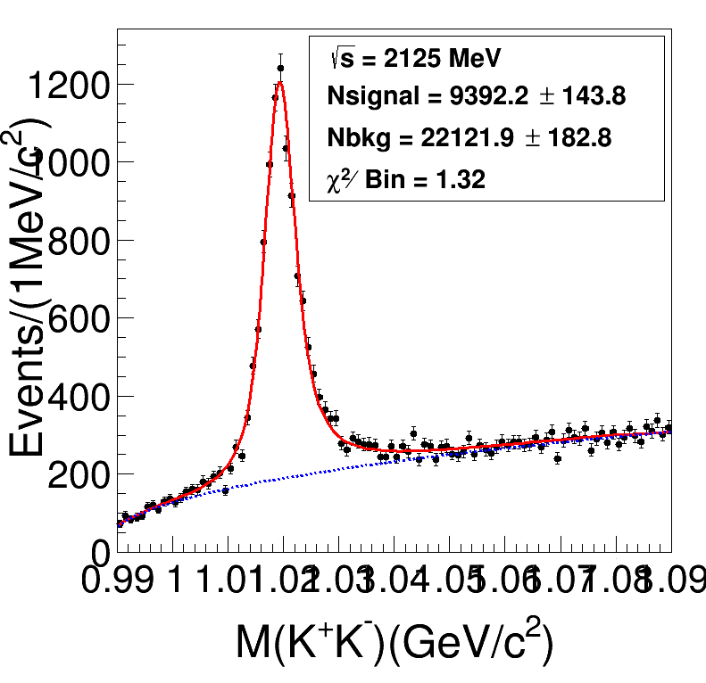
Preliminary Fitting

Slide 14
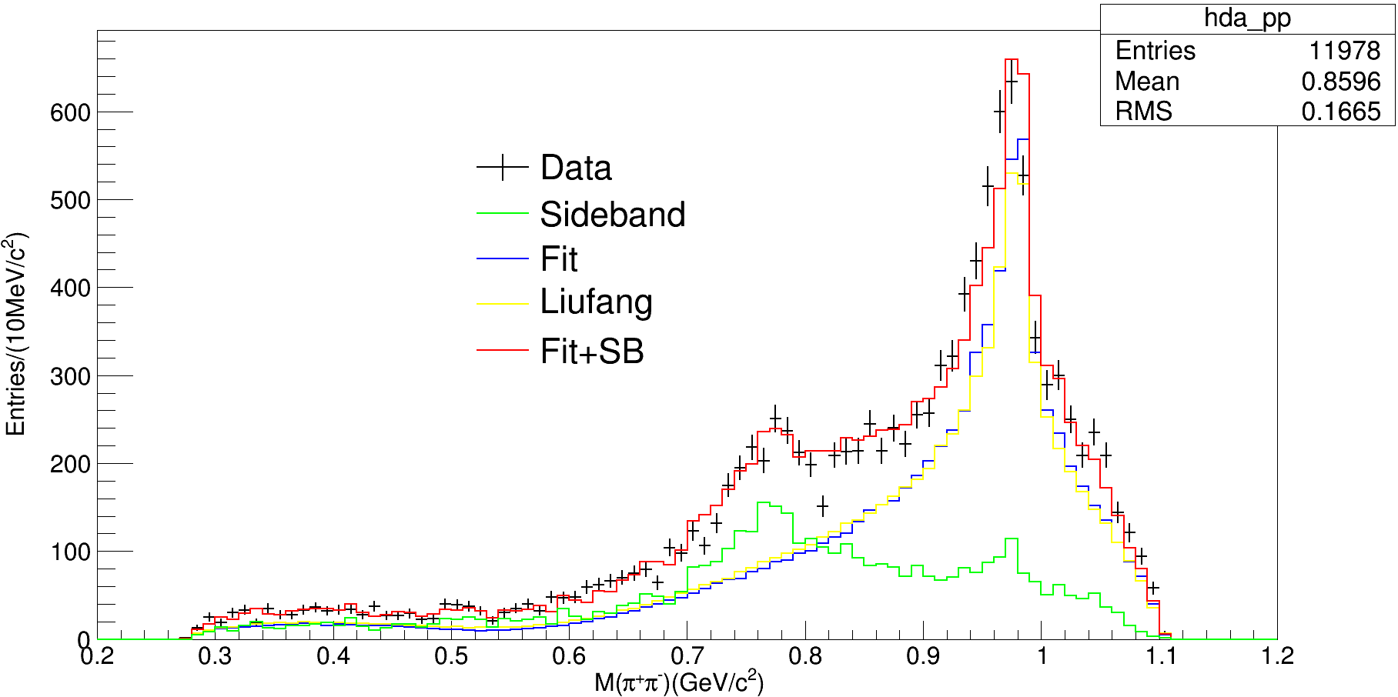
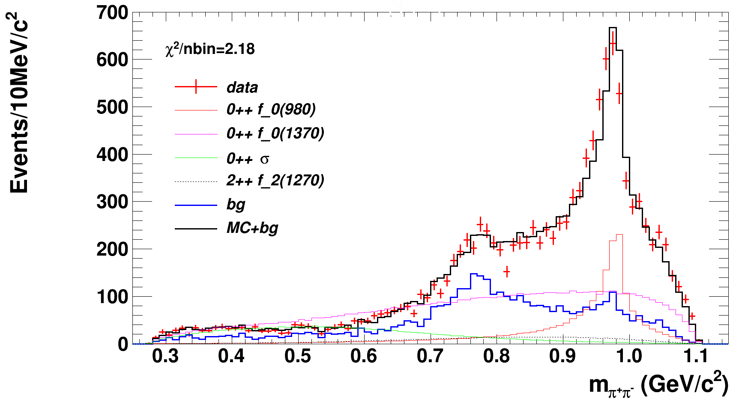
Preliminary Fitting
2scan/OK/scripe115
刘芳画图程序：

Slide 15
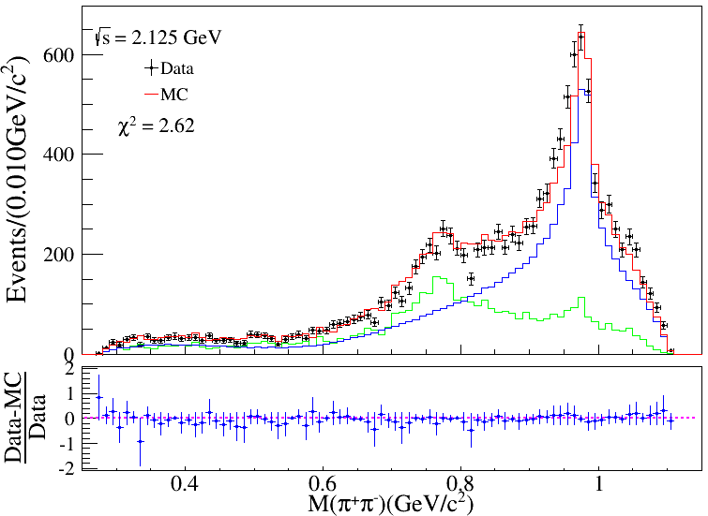
Preliminary Fitting
Liu Fang

Slide 16
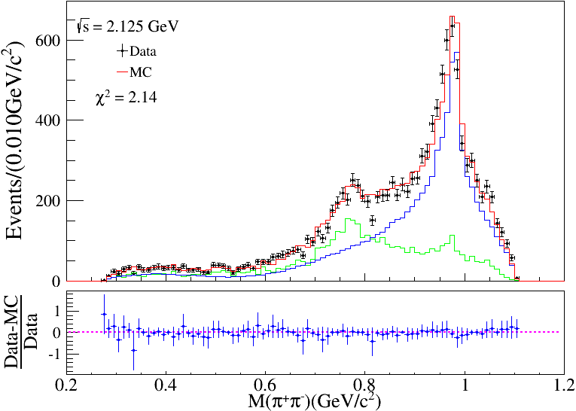
Preliminary Fitting
2scan/OK/scripe115
Tan Yx

Slide 17
Preliminary Fitting
comparation

Slide 18
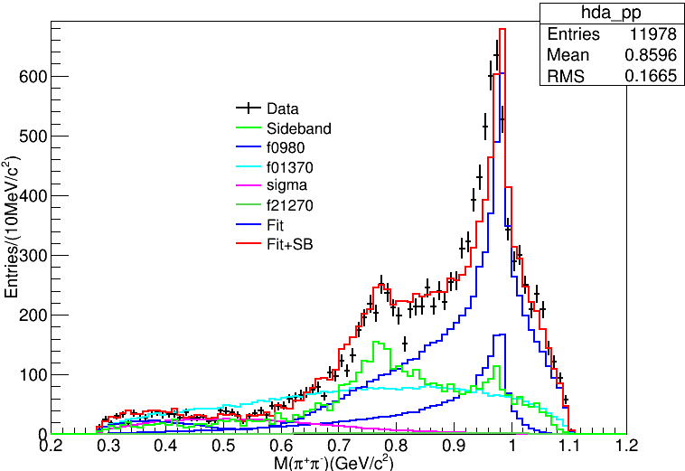
Preliminary Fitting
my result
Sun Yankun result

Slide 19
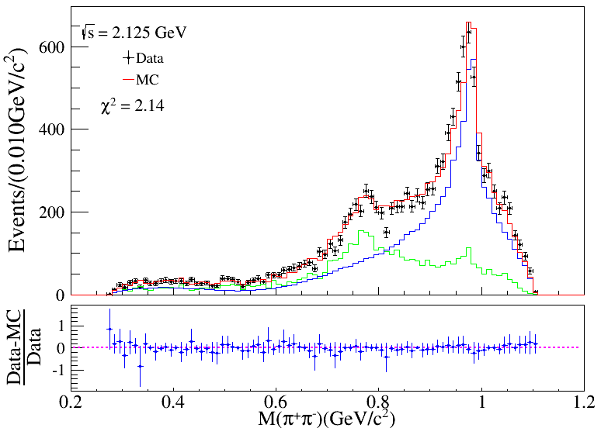
Model
6337M1: 1442; 1628($χ$²2.16); 127($χ$²2.10)
6325M1: 441
6342M2: 2013

Slide 20
Model
6342M2: 2013
6325M1: 441

Slide 21
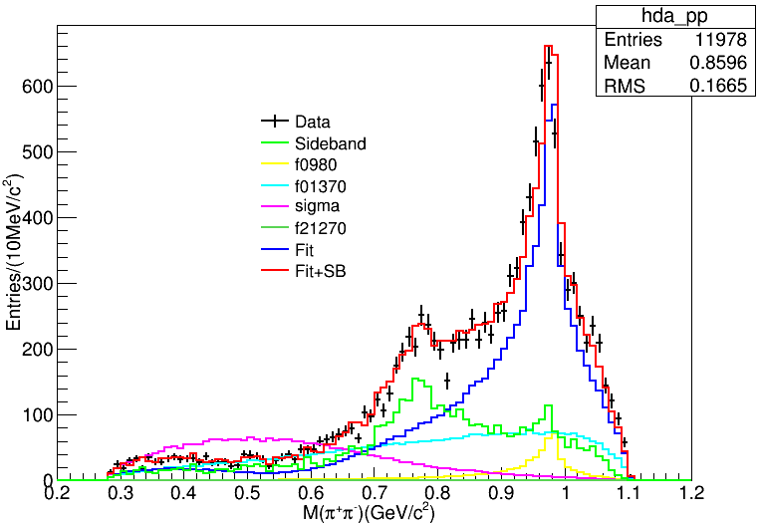
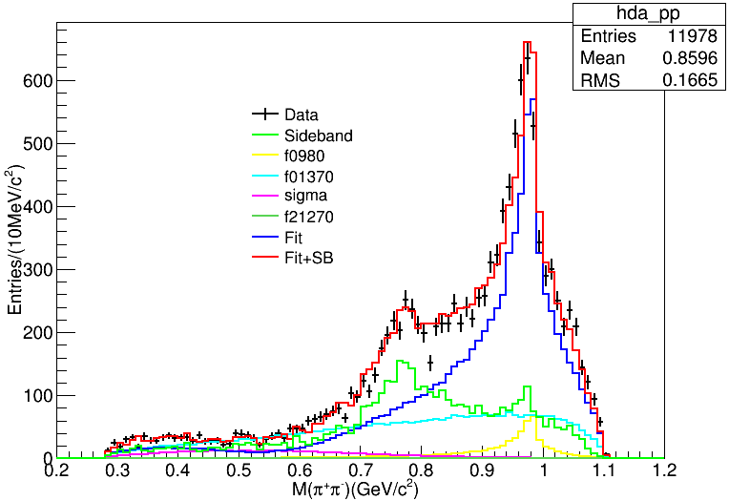
Model
6342M2: 2013
6325M1: 441

Slide 22
Model
 | Liu Fang | 2013(sigma) | 441
$$f_{0}(980)$$ | 19.4% | 8.6% | 11.2%
$$f_{0}(1370)$$ | 59.4% | 53.3% | 76.0%
$$σ$$ | 15.2% | 38.0% | 12.6%
$$f_{0}(2170)$$ | 5.9% | 0.1% | 0.2%
6342M2: 2013
6325M1: 441

Slide 23
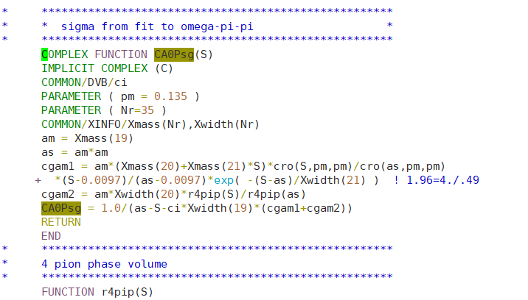
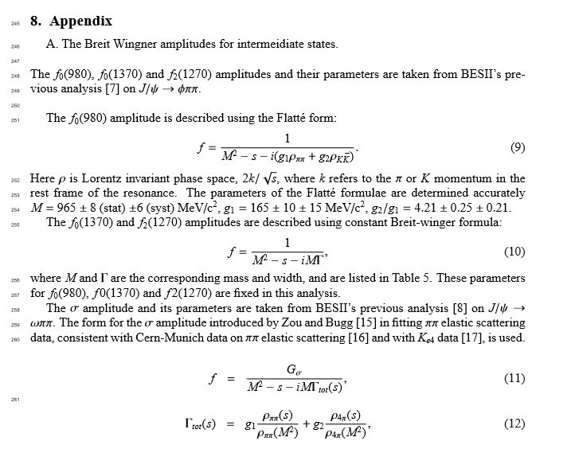
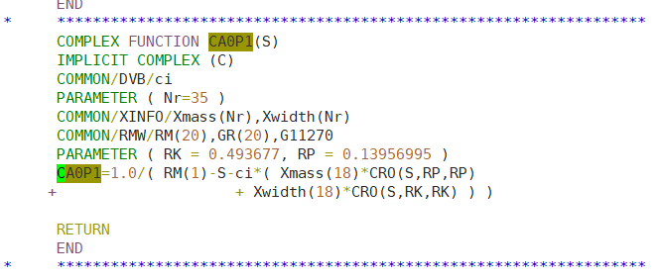
刘芳结果可能存在的问题
注意Pion的质量pm=0.135，为Pi0质量
同一程序内，f0(980)的传播子中pion的质量RP=0.139~，为Pi±的质量

Slide 24
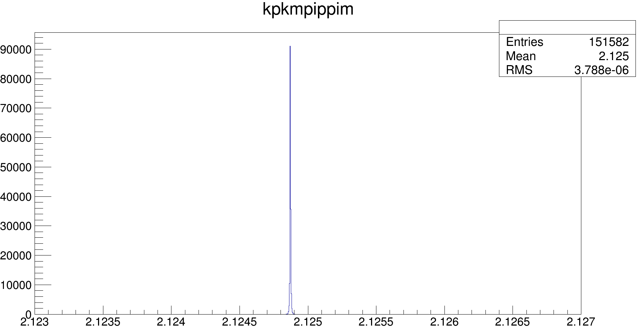
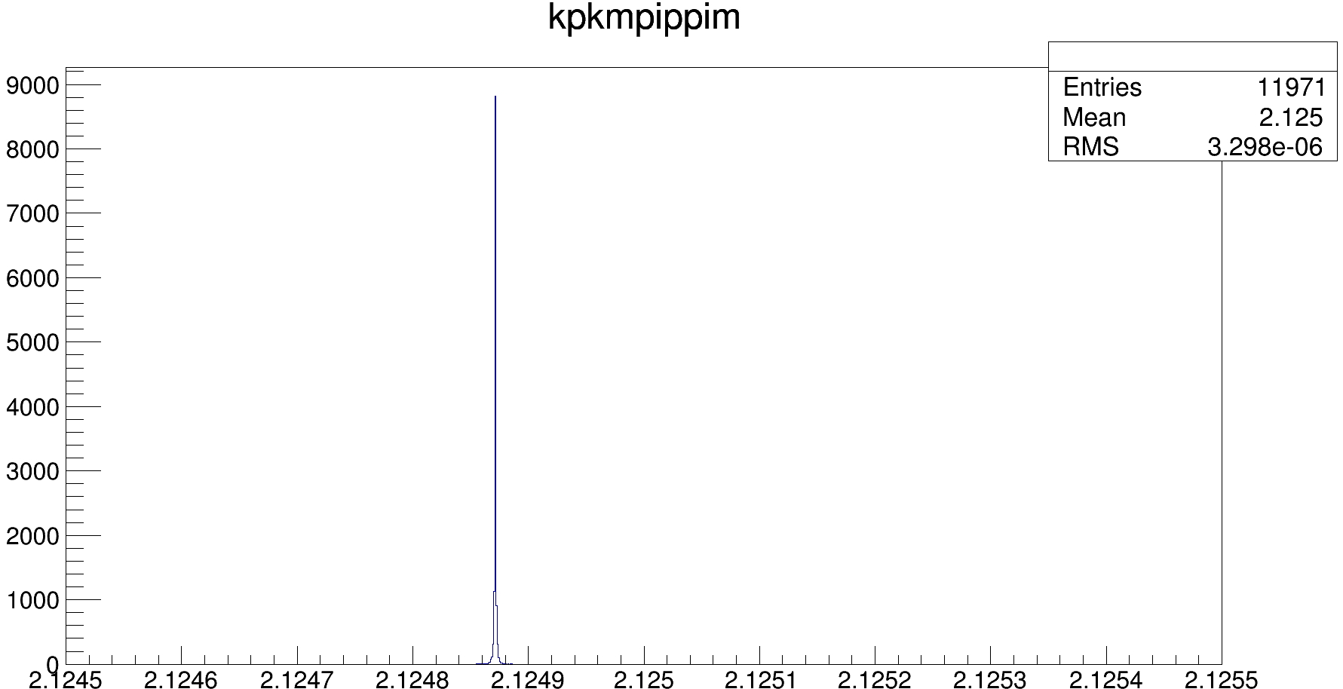

Slide 25
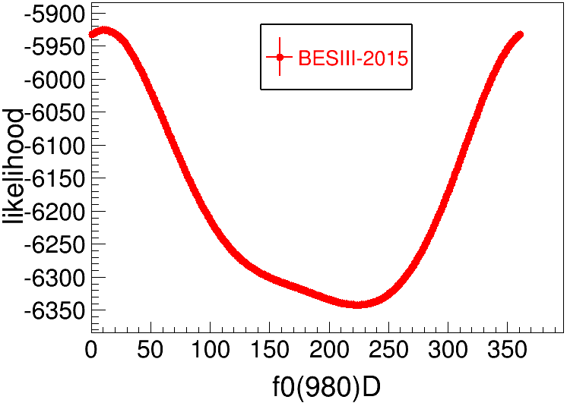
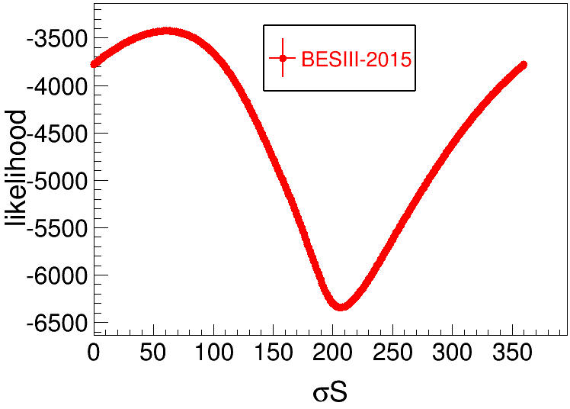
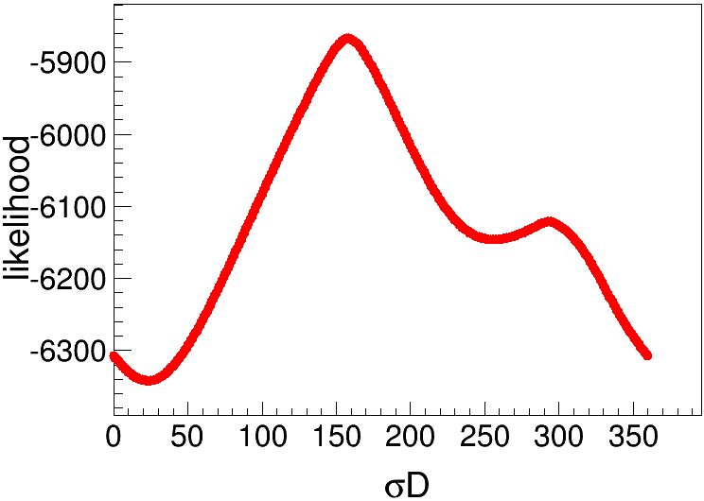
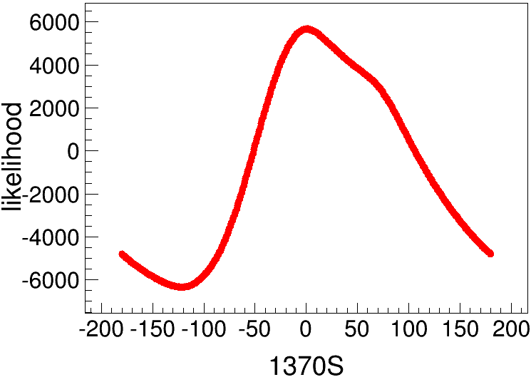
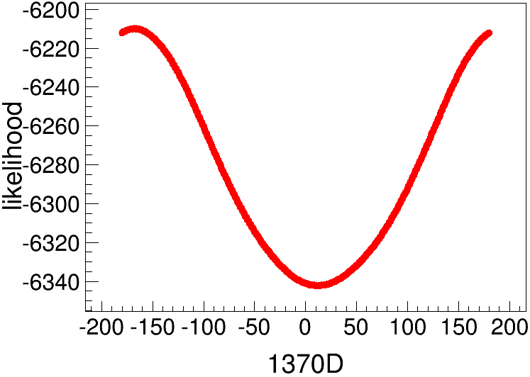
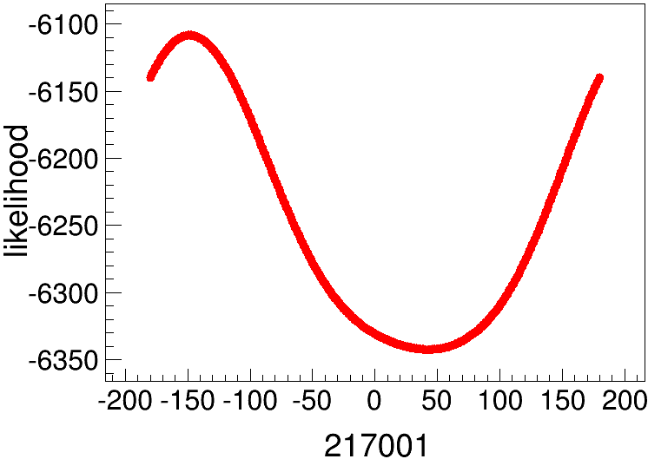
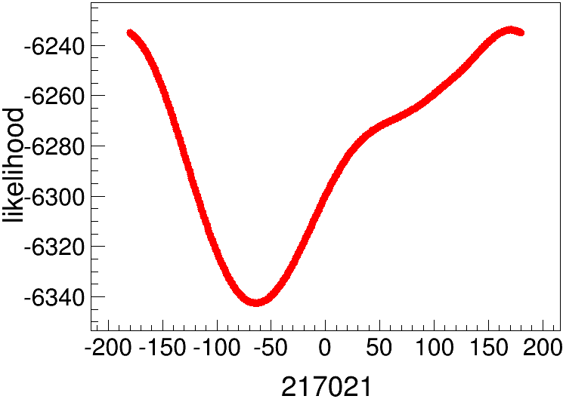
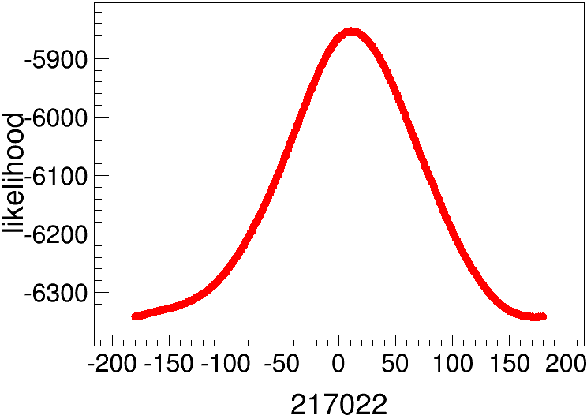
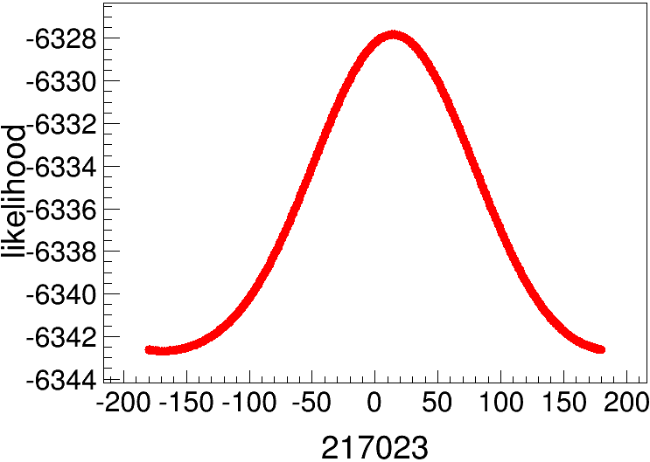
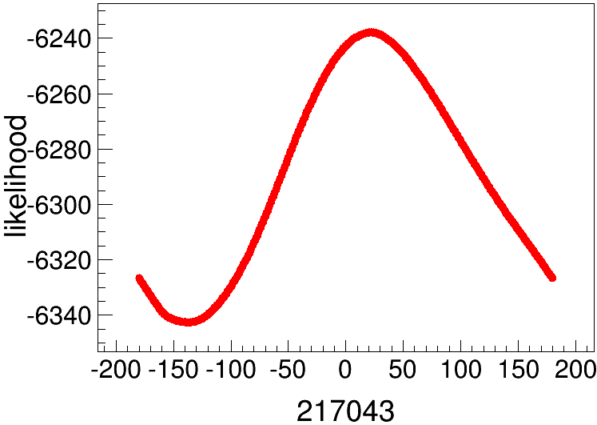

Slide 26
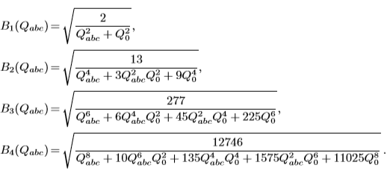
<$φf_{2}$(1270)|43>振幅函数 的形式：
——邹斌松文章
而
为Blatt-Weisskopf barrier factor [11,12]
所以
是角分布方程
因此 应该乘上B₄(Q_{abc}）

Slide 27
echo $CMTPATH 输出工作目录
/workfs/bes/tanyx/workarea-6.6.5.p01:本地目录
/afs/ihep.ac.cn/bes3/offline/Boss/6.6.5.p01:原始目录
统一对环境package编译的文件：
$TESTRELEASEROOT/cmt/requirements
UserDIY产生子模版：
/afs/ihep.ac.cn/bes3/offline/Boss/6.6.5.p01/Generator/BesEvtGen/BesEvtGen-00-01-96-slc6tag/

Slide 28
产生子目录：$BESEVTGENROOT/
在$TESTRELEASEROOT/cmt/requirements中修改环境默认产生子目录
对UserDIY MC：
在$BESEVTGENROOT/user/中添加振幅公式（UserPWATOTAL.cc 返回振幅的平方）
在$BESEVTGENROOT/src/EvtGen/EvtGenModels/中添加EvtPWATOTAL.hh和EvtPWATOTAL.cc，并修改EvtModelReg.cc
EvtPWATOTAL.hh要修改类名为EvtPWATOTAL，并作为头文件添加在UserPWATOTAL.cc中作为返回值的类名
EvtPWATOTAL.cc要包含头文件EvtPWATOTAL.hh，修改类名EvtPWATOTAL，修改model name
EvtModelReg.cc添加EvtPWATOTAL.hh和modellist：

Slide 29
$BESEVTGENROOT/share中：
pdt.table存有decay card中各种粒子的代码信息
DECAY.DEC存有decay card中各种衰变模式的代码信息
超链接的创建方式：
如在/hepustc/home/tanyx/创建/lustre/bes3/tanyx/（源文件）的超链接
不需要先创建空文件夹，应直接“ln -s /lustre/bes3/tanyx/ lustre”即可
同时复制多个文件夹A、B、C到文件夹target：
cp -r {A,B,c} target

Slide 30
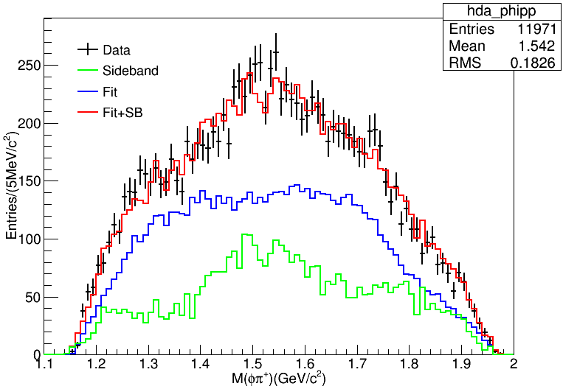
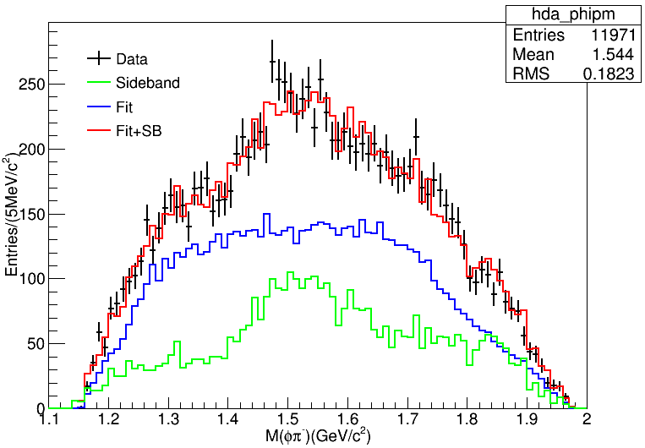
Preliminary Fitting

Slide 31
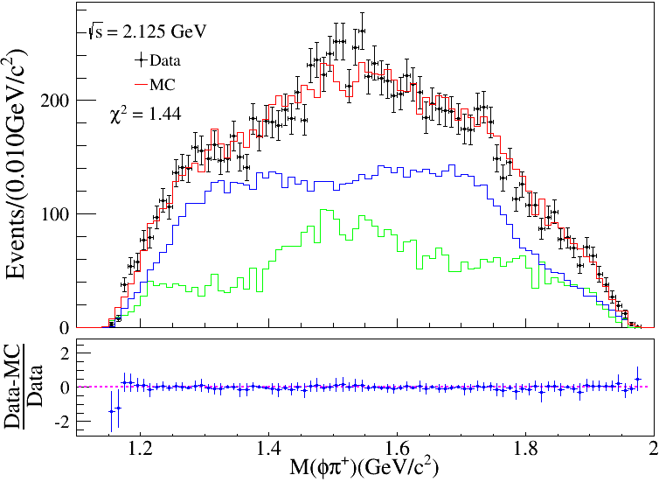
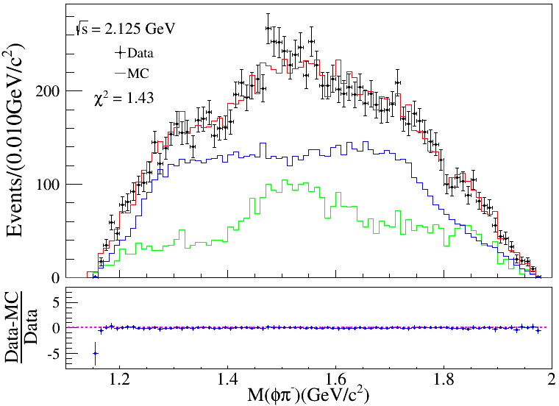
Preliminary Fitting
Bin=90

Slide 32
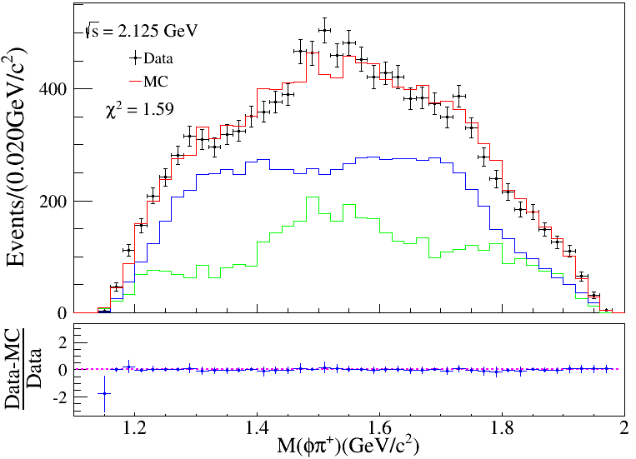
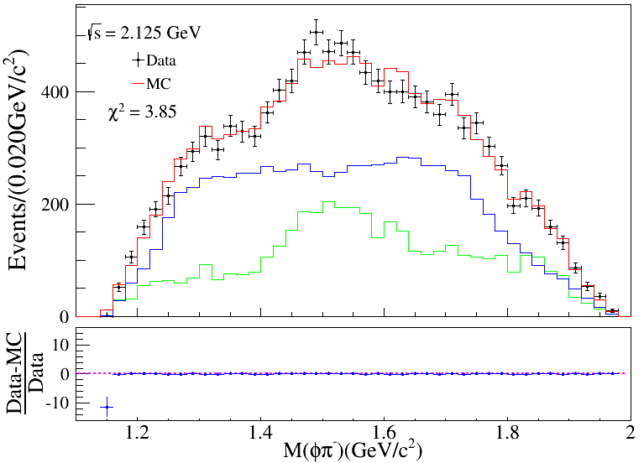
Preliminary Fitting
Bin=45

Slide 33
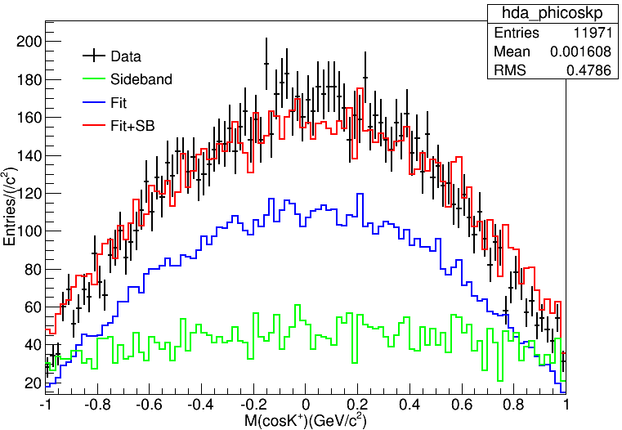
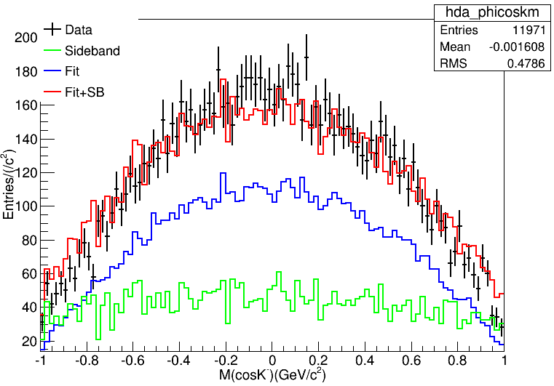
K boost to Phi

Slide 34
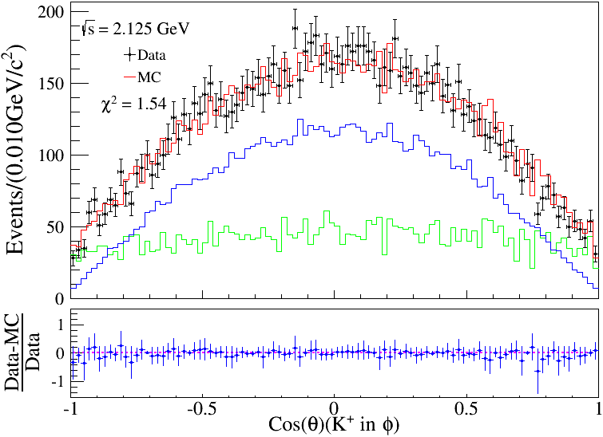
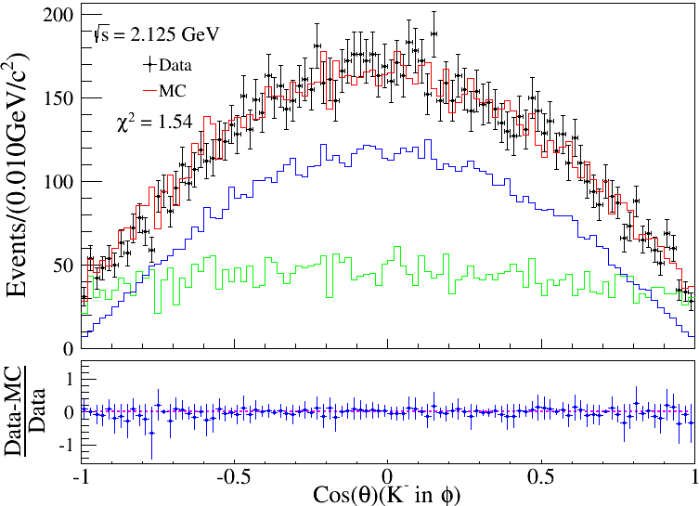
K boost to Phi
Bin=100

Slide 35
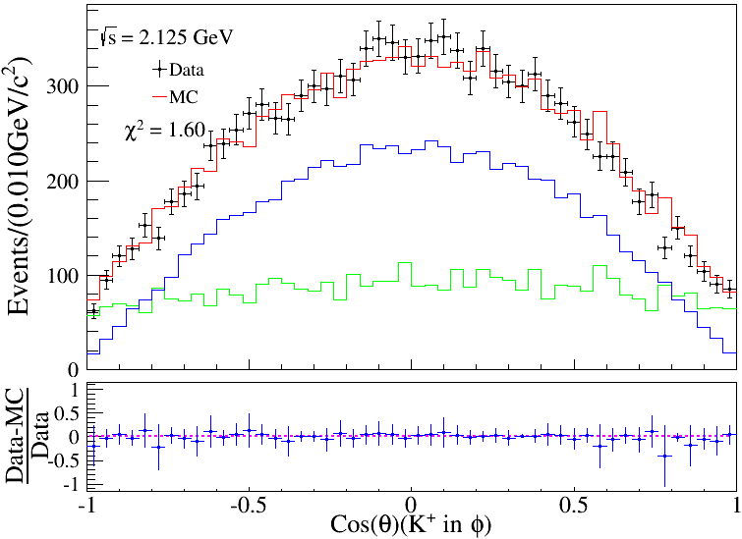
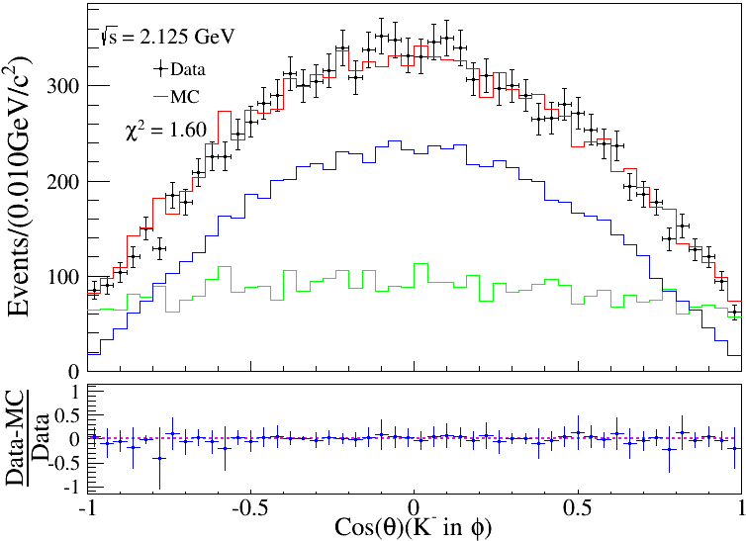
K boost to Phi
Bin=50

Slide 36
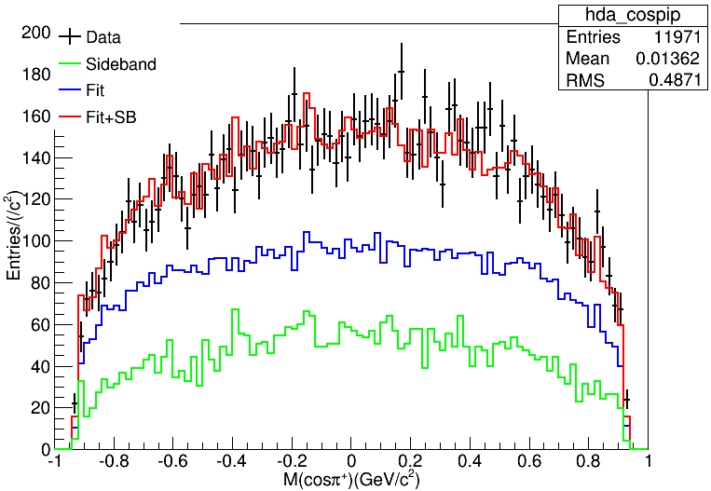
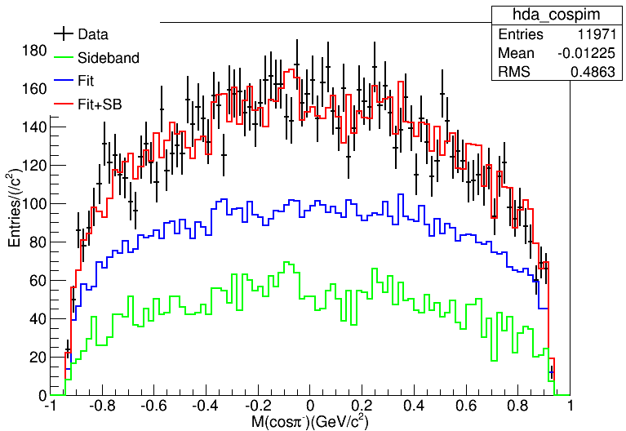
Pion

Slide 37
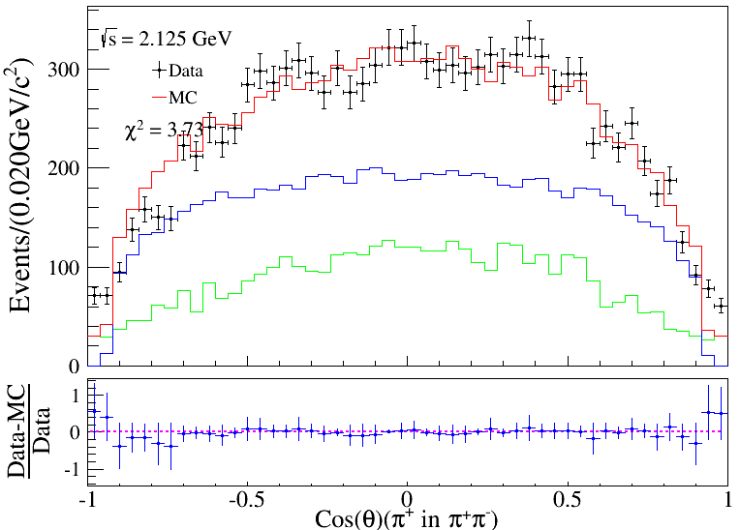
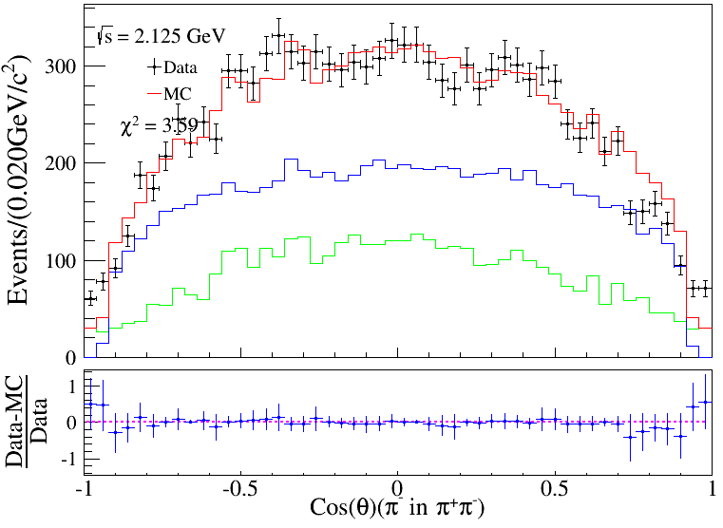
Pion
Bin=50

Slide 38
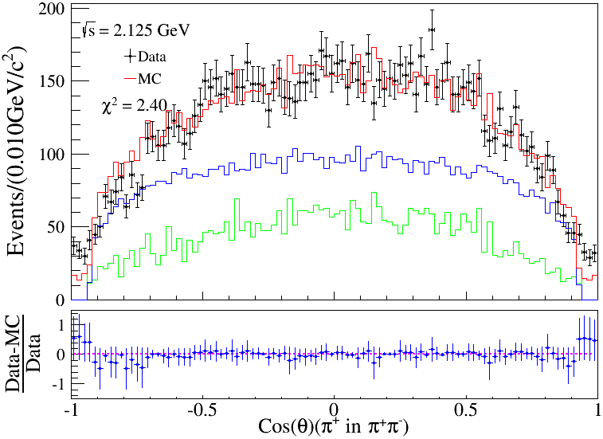
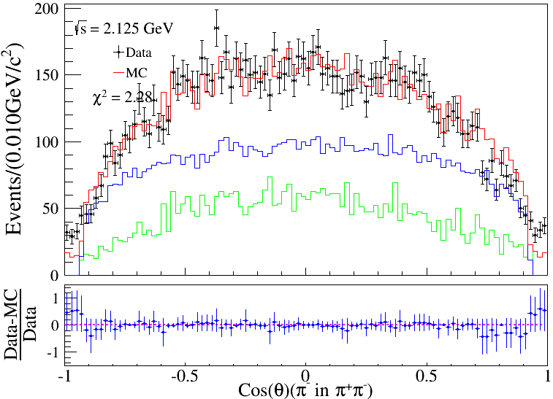
Pion
Bin=100

Slide 39
MC对比：刘芳 VS pwa

Slide 40
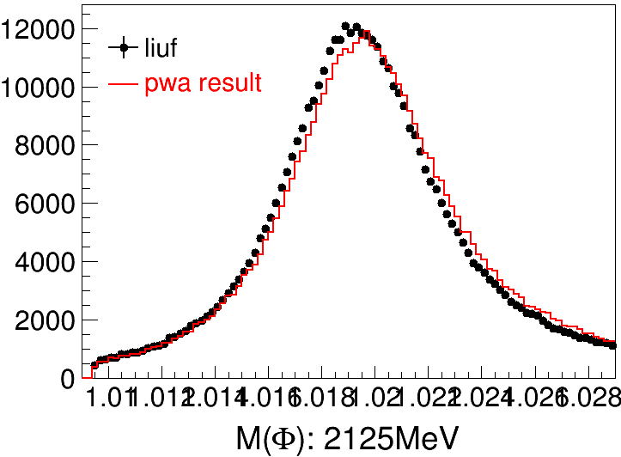
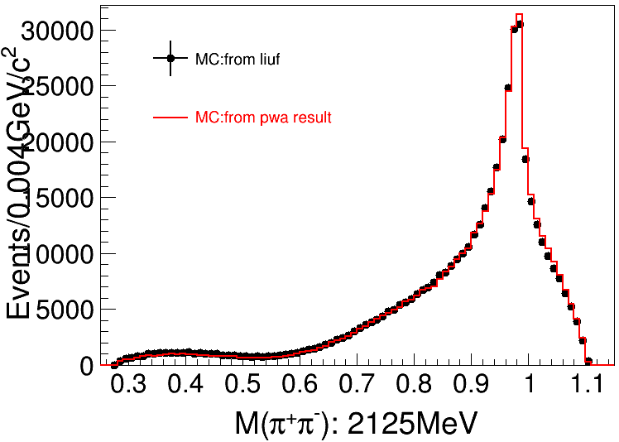
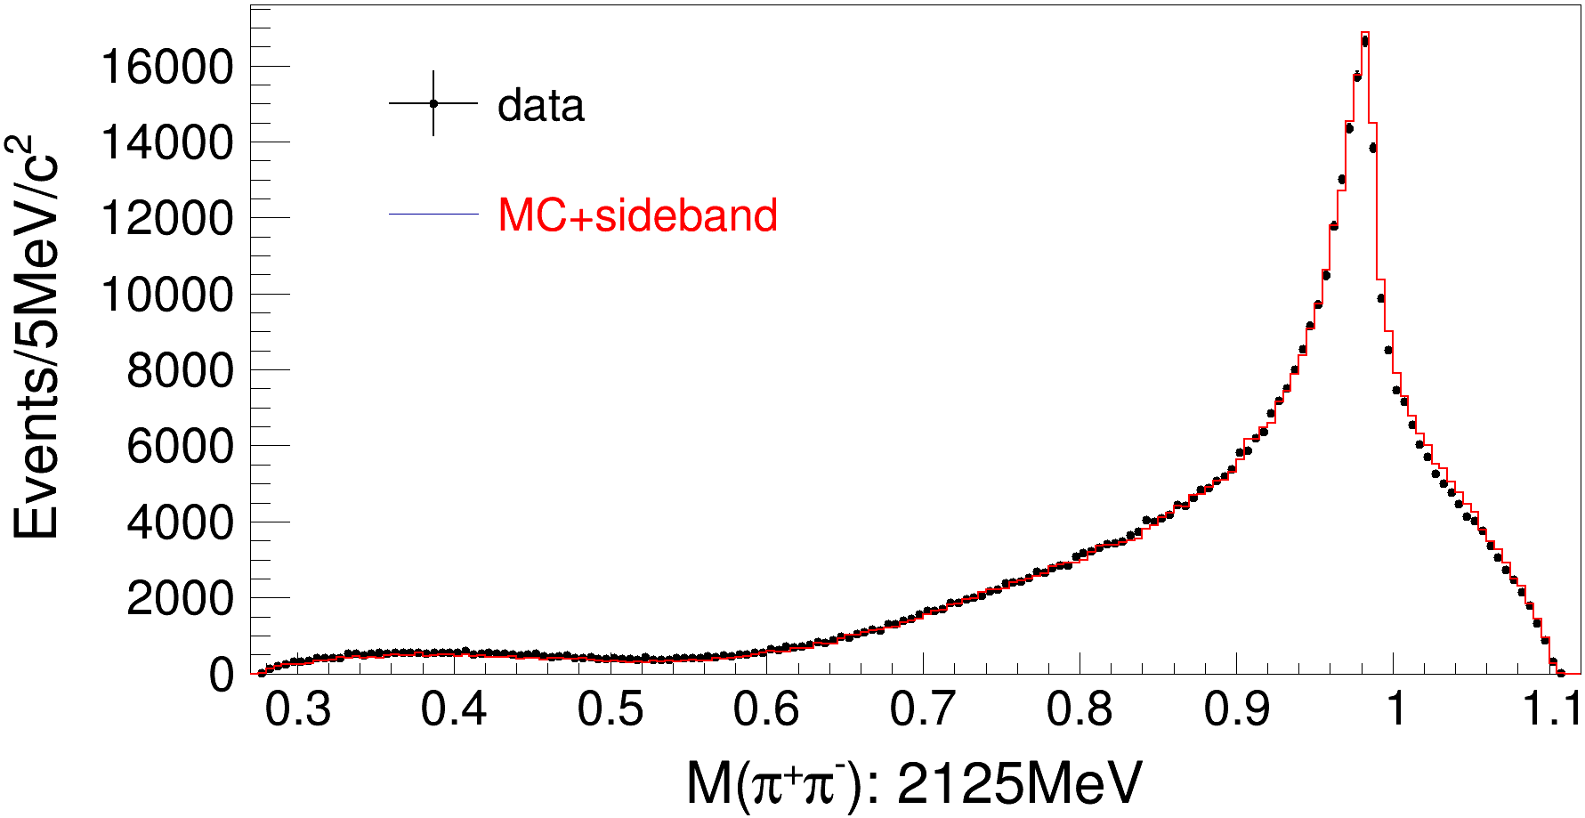

Slide 41
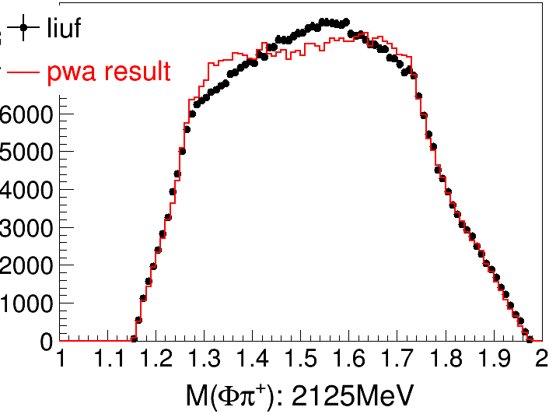

Slide 47
数据对比：数据 VS PWA MC+sideband

Slide 51
cosk

Slide 56
Numbers of NGoodCharge

Slide 60
cosk

Slide 65
2.396GeV

Slide 66
resonance
<$φf_{J}$|LS>
<$φf_{0}$|01> : phasespace, $f_{0}(980)$, $f_{0}\left(1370\right)$, $σ$,
<$φf_{0}$|21> : $f_{0}(980)$, $f_{0}(1370)$, $σ$
<$φf_{2}$|01> : $f_{2}(1270)$,
<$φf_{2}$|21> : $f_{2}(1270)$,
<$φf_{2}$|22> : $f_{2}(1270)$,
<$φf_{2}$|23> : $f_{2}(1270)$,
<$φf_{2}$|43> : $f_{2}(1270)$,

Slide 67
bkg/sid系数 = 1/(2+3)
2
1
3

Slide 68
resonance
<$φf_{J}$|LS>
<$φf_{0}$|01> : phasespace, $f_{0}(980)$, $f_{0}\left(1370\right)$, $σ$,
<$φf_{0}$|21> : $f_{0}(980)$, $f_{0}(1370)$, $σ$
<$φf_{2}$|01> : $f_{2}(1270)$,
<$φf_{2}$|21> : $f_{2}(1270)$,
<$φf_{2}$|22> : $f_{2}(1270)$,
<$φf_{2}$|23> : $f_{2}(1270)$,
<$φf_{2}$|43> : $f_{2}(1270)$,

Slide 69
PipPim

Slide 70
Preliminary Fitting

Slide 71
K boost to Phi
Bin=50

Slide 72
Pion
Bin=50

Slide 73
拟合一个能量点的步骤
1.拟合K+K-不变质量，计算本底/sideband系数用于background数据
2.产生拟合用数据.dat文件:
修改realdata地址、phspMC地址、MC数量、bkg/sid系数，编译运行，结果移入能量点文件夹
3.复制修改拟合文档
改creat.sh中地址，修改为产生一个文件夹并取消交后台
改PWAPdf.cxx中质心能量、数据地址（已移入能量点文件夹，替换能量数值）
改test.cxx中数据地址（已移入能量点文件夹，替换能量数值）
改run.sh中地址（文件夹按能量点区分，替换能量数值）
编译
4. creat.sh，前台测试
5.测试拟合不成功，批量交后台

Slide 74
Cross section: σ(e⁺e⁻→ ϕ(1020) π⁺π⁻)2400,
 | Lum.(pb⁻¹) |  |  |  |  |  | 本底/sideband系数 | phspMC数量 | MC信号数(0.98,1.09)
2.000 | 10.074 | 577.3± 46.8 | 1.01 | 34.1 | 48.9 | 340.3 ± 27.6 | 1.066 | 20000 | 34101/99990
2.050 | 3.343 | 191.6± 24.6 | 1.06 | 39.4 | 48.9 | 280.7 ± 36.0 | 1.06 | 20000 | 39433
2.100 | 12.167 | 1101.4± 51.1 | 1.00 | 39.3 | 48.9 | 471.0 ± 21.8 | 1.06 | 50000 | 39330
2.125 | 108.49 | 9376.8± 144.3 | 1.01 | 40.5 | 48.9 | 432.1 ± 6.7 | 1.05 | 150000 | 405274/1000000
2.150 | 2.841 | 220.0± 20.0 | 1.06 | 35.7 | 48.9 | 418.4 ± 38.1 | 0.95 | 20000 | 35731
2.175 | 10.625 | 761.2± 39.2 | 1.00 | 39.0 | 48.9 | 375.7 ± 19.3 | 1.05 | 20000 | 38951
2.200 | 13.699 | 706.6± 38.3 | 1.17 | 35.9 | 48.9 | 251.1 ± 13.6 | 1.02 | 20000 | 35873
2.232 | 11.856 | 435.5± 29.5 | 1.26 | 33.1 | 48.9 | 180.1 ± 12.2 | 1.07 | 20000 | 33126
2.309 | 21.089 | 587.6± 37.8 | 1.25 | 35.7 | 48.9 | 127.7 ± 8.2 | 1.016 | 20000 | 35662/99900
2.386 | 22.549 | 698.2± 37.0 | 1.12 | 40.9 | 48.9 | 138.2 ± 7.3 | 1.03 | 20000 | 40889
2.396 | 66.869 | 1978.8± 65.5 | 1.14 | 40.6 | 48.9 | 130.7 ± 4.3 | 1.02 | 50000 | 40623
2.644 | 34.003 | 501.3 ± 33.1 | 1.24 | 37.8 | 48.9 | 64.9 ± 4.3 | 1.07 | 10000 (change to 20000) | 37803
2.646 | 33.722 | 423.4± 29.7 | 1.25 | 36.8 | 48.9 | 55.4 ± 3.9 | 1.00 | 10000 (change to 20000) | 36853
2.900 | 105.253 | 687.4± 37.6 | 1.36 | 34.1 | 48.9 | 28.8 ± 1.6 | 0.99 | 20000 | 34074
2.950 | 15.942 | 114.4± 14.5 | 1.23 | 36.0 | 48.9 | 33.1 ± 4.2 | 1.05 | 2000 | 36026
2.981 | 16.071 | 72.5± 15.2 | 1.70 | 28.5 | 48.9 | 19.0 ± 4.0 | 1.08 | 2000 | 28483
3.000 | 15.881 | 75.2± 13.5 | 1.69 | 28.2 | 48.9 | 20.3 ± 3.6 | 1.05 | 2000 | 28164
3.020 | 17.29 | 78.2± 12.2 | 1.70 | 26.3 | 48.9 | 20.7 ± 3.2 | 1.00 | 2000 | 26266
3.080 | 126.185 | 577.2± 34.8 | 1.74 | 22.9 | 48.9 | 23.5 ± 1.4 | 0.98 | 20000 | 22918
选择程序质心能量2.2324
应该取什么值？

Slide 76
Systematic error: MCshape
 | Lum.(pb⁻¹) |  |  |  |  |  | σ (pb)Mcshape | Systematic error
2.000 | 10.074 | 577.0± 46.8 | 1.01 | 34.1 | 48.9 | 340.3 ± 27.6 | 360.0 25.4 | 5.8
2.050 | 3.343 | 191.5± 24.6 | 1.06 | 39.4 | 48.9 | 280.7 ± 36.0 | 288.8 33.8 | 2.9
2.100 | 12.167 | 110.7± 51.1 | 1.00 | 39.3 | 48.9 | 471.0 ± 21.8 | 483.2 21.5 | 2.6
2.125 | 108.49 | 9372.1± 144.7 | 1.01 | 40.5 | 48.9 | 432.1 ± 6.7 | 440.7 6.6 | 1.6
2.150 | 2.841 | 219.8± 20.0 | 1.06 | 35.7 | 48.9 | 418.4 ± 38.1 | 454.7 39.2 | 8.7
2.175 | 10.625 | 760.8± 39.1 | 1.00 | 39.0 | 48.9 | 375.7 ± 19.3 | 396.6 19.8 | 5.6
2.200 | 13.699 | 706.1± 38.3 | 1.17 | 35.9 | 48.9 | 251.1 ± 13.6 | 269.5 13.5 | 7.3
2.232 | 11.856 | 435.2± 29.5 | 1.26 | 33.1 | 48.9 | 180.1 ± 12.2 | 197.7 12.8 | 9.7
2.309 | 21.089 | 587.3± 37.7 | 1.25 | 35.7 | 48.9 | 127.7 ± 8.2 | 131.6 8.3 | 3.1
2.386 | 22.549 | 697.2± 37.0 | 1.12 | 40.9 | 48.9 | 138.2 ± 7.3 | 141.4 7.6 | 3.6
2.396 | 66.869 | 1977.7± 65.5 | 1.14 | 40.6 | 48.9 | 130.7 ± 4.3 | 134.3 4.2 | 2.8
2.644 | 34.003 | 501.0± 33.2 | 1.24 | 37.8 | 48.9 | 64.9 ± 4.3 | 69.8 4.2 | 7.6
2.646 | 33.722 | 423.4± 29.8 | 1.25 | 36.8 | 48.9 | 55.4 ± 3.9 | 58.1 3.7 | 4.9
2.900 | 105.253 | 687.0± 37.7 | 1.36 | 34.1 | 48.9 | 28.8 ± 1.6 | 30.7 1.5 | 6.6
2.950 | 15.942 | 114.4± 14.6 | 1.23 | 36.0 | 48.9 | 33.1 ± 4.2 | 35.0 4.3 | 6.8
2.981 | 16.071 | 72.4± 15.2 | 1.70 | 28.5 | 48.9 | 19.0 ± 4.0 | 19.9 3.6 | 1.6
3.000 | 15.881 | 74.6± 13.4 | 1.69 | 28.2 | 48.9 | 20.3 ± 3.6 | 22.3 3.5 | 8.9
3.020 | 17.29 | 78.1± 12.6 | 1.70 | 26.3 | 48.9 | 20.7 ± 3.2 | 22.7 3.4 | 9.1
3.080 | 126.185 | 577.0± 34.8 | 1.74 | 22.9 | 48.9 | 23.5 ± 1.4 | 25.5 1.4 | 8.5
选择程序质心能量2.2324
应该取什么值？

Slide 77
Systematic error: range
 |  |  |  | N(φ) | Ε(%) | σ (pb) | Systematic error
2.000 | 577.0± 46.8 | 34.1 | 340.3 ± 27.6 | 568.32± 45.7 | 34.2 | 334.0 26.9 | 1.8
2.050 | 191.5± 24.6 | 39.4 | 280.7 ± 36.0 | 188.53± 24.1 | 39.5 | 275.4 35.2 | 1.8
2.100 | 110.7± 51.1 | 39.3 | 471.0 ± 21.8 | 1101.7± 50.3 | 39.5 | 468.8 21.4 | 0.4
2.125 | 9372.1± 144.7 | 40.5 | 432.1 ± 6.7 | 9401.2± 142.9 | 40.7 | 431.1 6.6 | 0.2
2.150 | 219.8± 20.0 | 35.7 | 418.4 ± 38.1 | 213.4± 19.4 | 35.9 | 403.7 36.7 | 3.4
2.175 | 760.8± 39.1 | 39.0 | 375.7 ± 19.3 | 776.0± 37.7 | 39.1 | 382.0 18.6 | 1.7
2.200 | 706.1± 38.3 | 35.9 | 251.1 ± 13.6 | 704.4± 36.7 | 36.0 | 249.7 13.0 | 0.5
2.232 | 435.2± 29.5 | 33.1 | 180.1 ± 12.2 | 444.2± 29.2 | 33.4 | 182.1 12.0 | 1.2
2.309 | 587.3± 37.7 | 35.7 | 127.7 ± 8.2 | 584.3± 36.9 | 35.8 | 126.6 8.0 | 0.8
2.386 | 697.2± 37.0 | 40.9 | 138.2 ± 7.3 | 673.8± 38.0 | 41.1 | 132.8 7.5 | 3.8
2.396 | 1977.7± 65.5 | 40.6 | 130.7 ± 4.3 | 1993.3± 64.5 | 40.8 | 131.1 4.2 | 0.3
2.644 | 501.0± 33.2 | 37.8 | 64.9 ± 4.3 | 498.3± 32.7 | 38.0 | 64.1 4.2 | 1.1
2.646 | 423.4± 29.8 | 36.8 | 55.4 ± 3.9 | 425.5± 29.4 | 37.0 | 55.3 3.8 | 0.2
2.900 | 687.0± 37.7 | 34.1 | 28.8 ± 1.6 | 689.3± 37.5 | 34.3 | 28.7 1.6 | 0.3
2.950 | 114.4± 14.6 | 36.0 | 33.1 ± 4.2 | 115.3± 14.4 | 36.2 | 33.2 4.2 | 0.3
2.981 | 72.4± 15.2 | 28.5 | 19.0 ± 4.0 | 69.8± 14.8 | 28.6 | 18.3 3.9 | 3.7
3.000 | 74.6± 13.4 | 28.2 | 20.3 ± 3.6 | 73.0± 13.2 | 28.3 | 19.7 3.6 | 2.0
3.020 | 78.1± 12.6 | 26.3 | 20.7 ± 3.2 | 77.3± 12.1 | 26.4 | 20.4 3.2 | 1.4
3.080 | 577.0± 34.8 | 22.9 | 23.5 ± 1.4 | 578.5± 34.7 | 23.0 | 23.4 1.4 | 0.4
选择程序质心能量2.2324
应该取什么值？

Slide 78
Systematic error: range
 |  |  |  | N(φ) | N:Ε(%) | σ (pb) | Systematic error
2.000 | 577.0± 46.8 | 34.1 | 340.3 ± 27.6 | 568.315 45.723 | 34214 | 334.0 26.9
2.050 | 191.5± 24.6 | 39.4 | 280.7 ± 36.0 | 188.528 24.0967 | 39540 | 275.4 35.2
2.100 | 110.7± 51.1 | 39.3 | 471.0 ± 21.8 | 1101.67 50.2858 | 39473 | 468.8 21.4
2.125 | 9372.1± 144.7 | 40.5 | 432.1 ± 6.7 | 9401.17 142.862 | 406805 | 431.1 6.6
2.150 | 219.8± 20.0 | 35.7 | 418.4 ± 38.1 | 213.435 19.4112 | 35913 | 403.7 36.7
2.175 | 760.8± 39.1 | 39.0 | 375.7 ± 19.3 | 776.022 37.74 | 39119 | 382.0 18.6
2.200 | 706.1± 38.3 | 35.9 | 251.1 ± 13.6 | 704.437 36.6979 | 36021 | 249.7 13.0
2.232 | 435.2± 29.5 | 33.1 | 180.1 ± 12.2 | 444.205 29.2438 | 33374 | 182.1 12.0
2.309 | 587.3± 37.7 | 35.7 | 127.7 ± 8.2 | 584.258 36.9345 | 35822 | 126.6 8.0
2.386 | 697.2± 37.0 | 40.9 | 138.2 ± 7.3 | 673.849 38.0142 | 41085 | 132.8 7.5
2.396 | 1977.7± 65.5 | 40.6 | 130.7 ± 4.3 | 1993.33 64.4941 | 40805 | 131.1 4.2
2.644 | 501.0± 33.2 | 37.8 | 64.9 ± 4.3 | 498.298 32.6699 | 37964 | 64.1 4.2
2.646 | 423.4± 29.8 | 36.8 | 55.4 ± 3.9 | 425.534 29.3954 | 37024 | 55.3 3.8
2.900 | 687.0± 37.7 | 34.1 | 28.8 ± 1.6 | 689.338 37.5336 | 34271 | 28.7 1.6
2.950 | 114.4± 14.6 | 36.0 | 33.1 ± 4.2 | 115.274 14.4486 | 36220 | 33.2 4.2
2.981 | 72.4± 15.2 | 28.5 | 19.0 ± 4.0 | 69.7851 14.7936 | 28643 | 18.3 3.9
3.000 | 74.6± 13.4 | 28.2 | 20.3 ± 3.6 | 73.0304 13.2477 | 28333 | 19.7 3.6
3.020 | 78.1± 12.6 | 26.3 | 20.7 ± 3.2 | 77.2791 12.1113 | 26424 | 20.4 3.2
3.080 | 577.0± 34.8 | 22.9 | 23.5 ± 1.4 | 578.462 34.7144 | 23045 | 23.4 1.4
选择程序质心能量2.2324
应该取什么值？

Slide 79
拟合一个能量点的步骤
1.拟合K+K-不变质量，计算本底/sideband系数用于background数据
（已移入能量点文件夹，替换能量数值）
/besfs/users/tanyx/Run665p01_tanyx/pwa_c++/zhangyt/datae/normalization
2.产生拟合用数据.dat文件:
修改realdata地址、phspMC地址（已移入能量点文件夹，替换能量数值）
修改MC数量、bkg/sid系数，编译运行，结果移入能量点文件夹
/besfs/users/tanyx/Run665p01_tanyx/pwa_c++/zhangyt/datae/sun
3.复制修改拟合文档
改creat.sh中地址（已移入能量点文件夹，替换能量数值），修改为产生一个文件夹并取消交后台
改PWAPdf.cxx中质心能量、数据地址（已移入能量点文件夹，替换能量数值）
改test.cxx中数据地址（已移入能量点文件夹，替换能量数值）
改run.sh中地址（文件夹按能量点区分，替换能量数值）
编译
4. creat.sh，前台测试
5.测试拟合不成功，批量交后台

Slide 83
Backup

Slide 84
Cross section: σ(e⁺e⁻→ ϕ(1020) π⁺π⁻)2400,
 | Lum.(pb⁻¹) |  |  |  |  |  | 本底/sideband系数 | phspMC数量
2.000 | 10.074 | 646.3±47.3 | 1.00676 | 42.28 | 48.9 | 308.1±22.5 | 1.066 | 20000
2.050 | 3.343 | 220.0±25.6 | 1.05849 | 42.951 | 48.9 | 295.6±34.4 | 1.06 | 20000
2.100 | 12.167 | 1186.6±51.4 | 1.00037 | 45.401 | 48.9 | 439.1±19.0 | 1.06 | 50000
2.125 | 108.49 | 10430.6±146.5 | 1.00462 | 45.051 | 48.9 | 434.9±6.1 | 1.05 | 150000
2.150 | 2.841 | 232.0±21.1 | 1.05662 | 43.864 | 48.9 | 360.0±32.7 | 0.95 | 20000
2.175 | 10.625 | 835.8±39.8 | 1.00139 | 46.205 | 48.9 | 347.7±16.6 | 1.05 | 20000
2.200 | 13.699 | 786.2±38.8 | 1.16337 | 41.938 | 48.9 | 240.7±11.9 | 1.02 | 20000
2.232 | 11.856 | 477.7±29.9 | 1.25852 | 38.693 | 48.9 | 169.1±10.6 | 1.07 | 20000
2.309 | 21.089 | 649.0±37.0 | 1.24758 | 38.875 | 48.9 | 129.7±7.4 | 1.016 | 20000
2.386 | 22.549 | 764.7±38.7 | 1.12213 | 43.069 | 48.9 | 143.4±7.3 | 1.03 | 20000
2.396 | 66.869 | 2166.6±65.4 | 1.13384 | 43.395 | 48.9 | 134.7±4.1 | 1.02 | 50000
2.644 | 34.003 | 562.9±33.8 | 1.2365 | 40.86 | 48.9 | 67.5±4.1 | 1.07 | 10000 (change to 20000)
2.646 | 33.722 | 435.8±29.5 | 1.24615 | 40.288 | 48.9 | 52.2±3.5 | 1.00 | 10000 (change to 20000)
2.900 | 105.253 | 730.7±38.7 | 1.3632 | 37.189 | 48.9 | 28.0±1.5 | 0.99 | 20000
2.950 | 15.942 | 122.9±14.8 | 1.23203 | 39.033 | 48.9 | 32.8±4.0 | 1.05 | 2000 para
2.981 | 16.071 | 84.9±14.0 | 1.6961 | 30.516 | 48.9 | 20.9±3.4 | 1.08 | 2000
3.000 | 15.881 | 70.9±12.0 | 1.68895 | 29.335 | 48.9 | 18.5±3.1 | 1.05 | 2000
3.020 | 17.29 | 87.4±13.2 | 1.70095 | 28.729 | 48.9 | 21.2±3.2 | 1.00 | 2000
3.080 | 126.185 | 649.0±35.8 | 1.73723 | 25.3 | 48.9 | 23.9±1.3 | 0.98 | 20000
选择程序质心能量2.2324
应该取什么值？

