Slide 1
Study of $e^{+}e^{−}→n\overline{n}$ @BESIII @2.396 GeV
Jifeng Hu

Slide 2
Outline
Cut-based results with
Double EMC+TOF
(EMC+TOF) + TOF
Trigger efficiency correction

Slide 3
Selections Chain of Double (EMC+TOF)
Selections | Expressions | MC CONEXC | MC control | DATA control
Generator | - | 294511 (400000)
Neutral events | $$N_{±}=0,N_{γ}≥1$$ | 85.57%
EMC1 | $$0.025<E_{1}<2.0 GeV, \left|\cos{θ}\right|<0.8$$ | 92.57%
Valid t₀ | $$t_{0}>0$$ | 57.99%
TOF1 | $\left|t_{1}−t_{0}−t_{γ}\right|<10 ns,{Δθ}_{EMC}^{TOF}<0.2$ | 91.71% | 45.20% | 34.72%
EMC2 | $$0.025<E_{2}<0.7 GeV$$ | 68.61%
TOF2 | $\left|t_{2}−t_{0}−t_{γ}\right|<10$ ns | 14.60% | 8.23% | 7.91%
Open angle | ${Δθ}_{1,2}>2.7$ | 79.35%
Time difference | $\left|t_{1}−t_{2}\right|<3$ ns | 74.52%
Number of hits of leading shower | $${30<N}_{hit}<100$$ | 46.7%

Slide 4
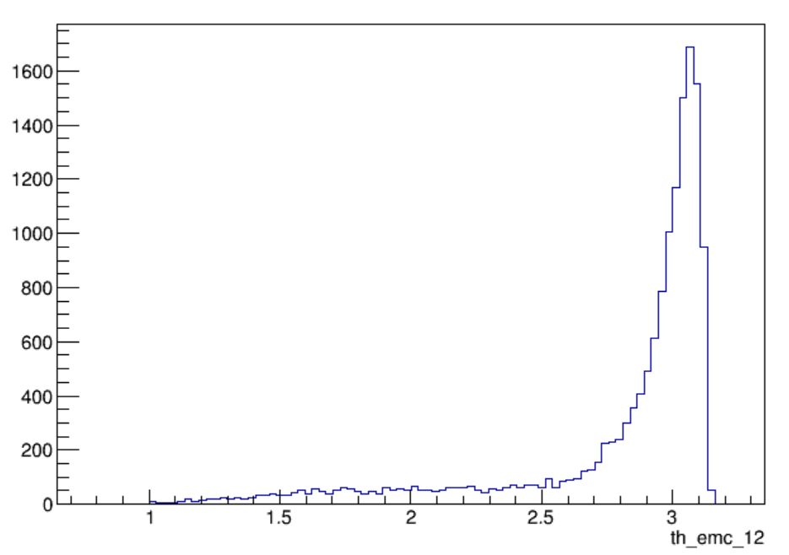
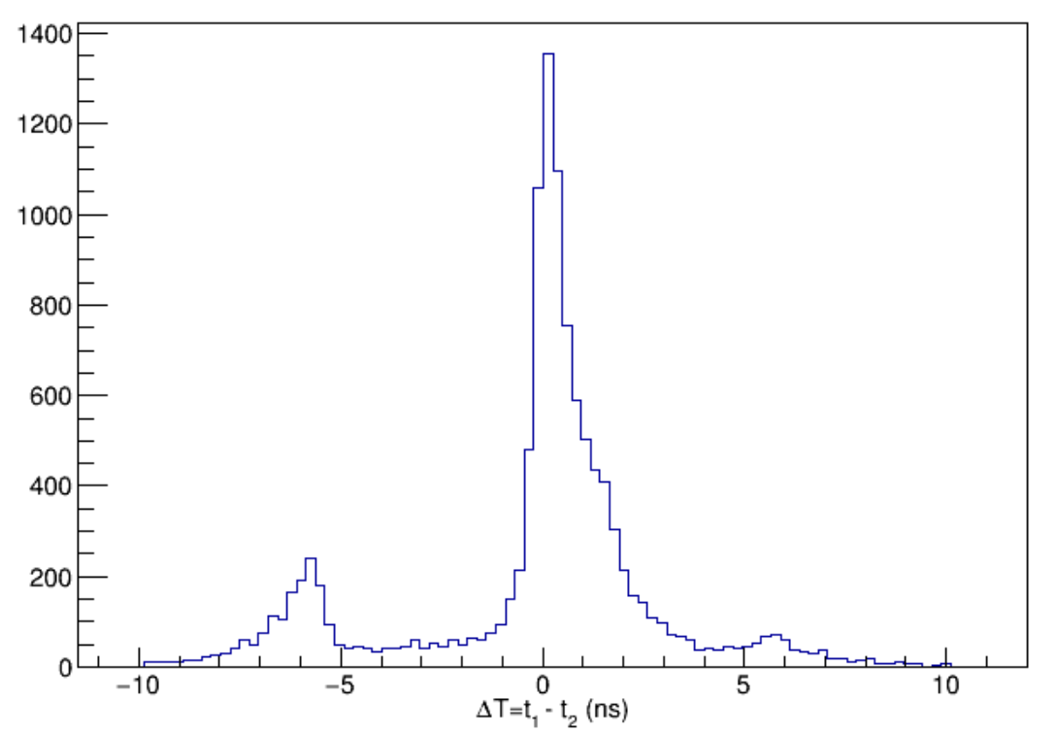
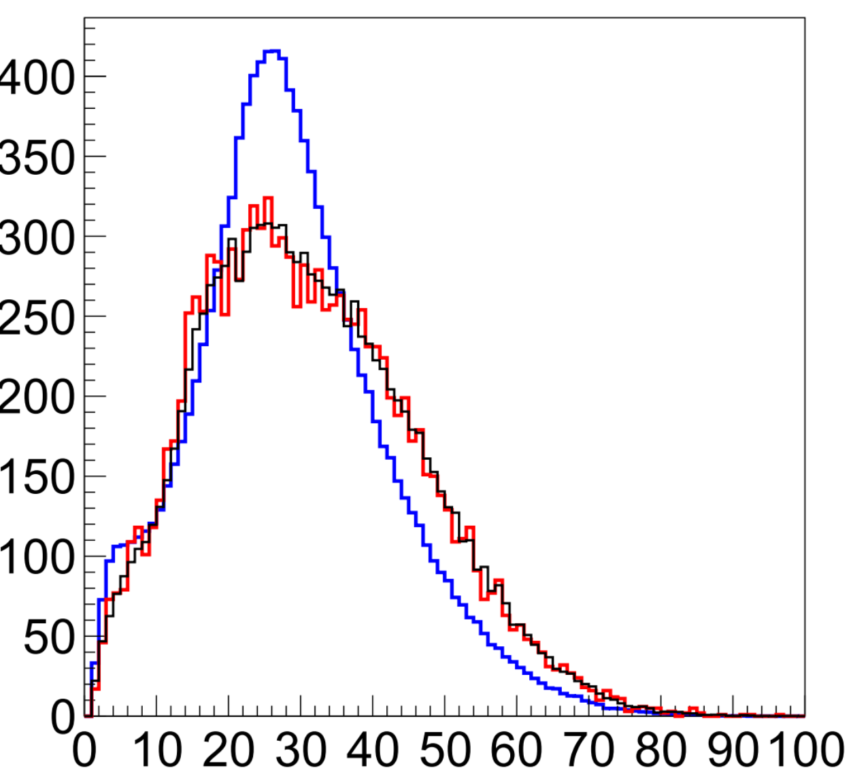
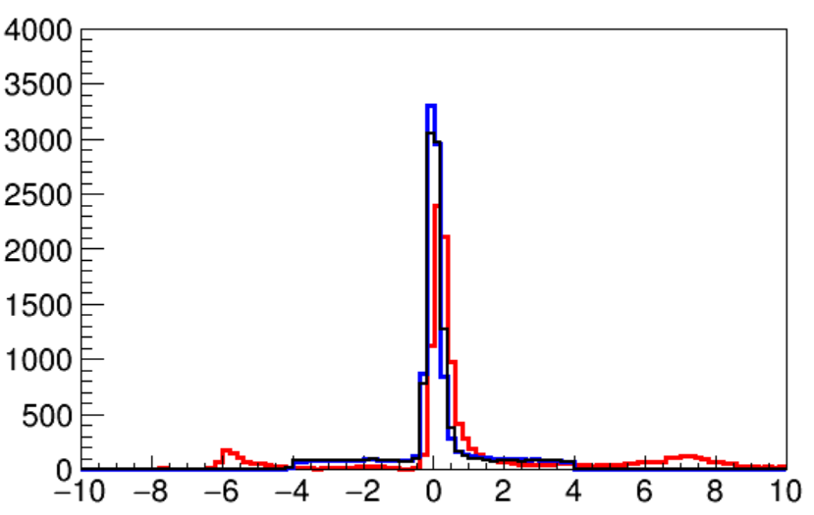
More Verification Needed
Open angle

Slide 5
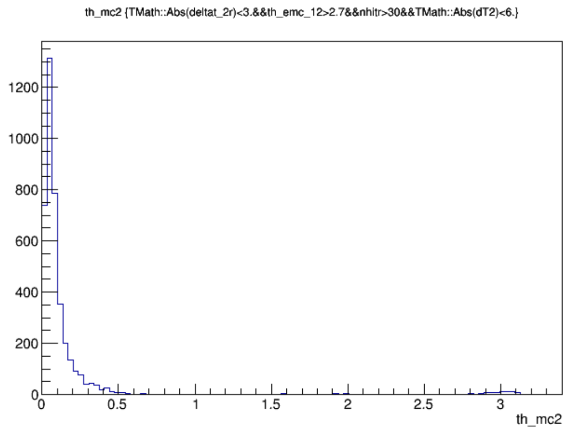
Quality of MC Event Candidates
Open angle of the leading shower to anti-neutron truth momentum
Open angle of the second shower to neutron truth momentum
2.6% misidentification

Slide 6
Fitting
(EMC+TOF) + (EMC+TOF)
Eff=1.0%, XS = 81.72 ± 20.36 (pb), significance = 3.0σ
Fine optimization could improve significance more than 5σ.

Slide 7
Selections Chain of (EMC+TOF + TOF)
Selections | Expressions | MC CONEXC | MC control | DATA control
Generator | - | 294511
Neutral events | $$N_{±}=0,N_{γ}≥1$$ | 85.57%
EMC1 | $$0.025<E_{1}<2.0 GeV, \left|\cos{θ}\right|<0.8$$ | 92.57%
Valid t₀ | $$t_{0}>0$$ | 57.99%
TOF1 | $\left|t_{1}−t_{0}−t_{γ}\right|<10 ns,{Δθ}_{EMC}^{TOF}<0.2$ | 91.71% | 45.20% | 34.72%
EMC2 | $$E_{2}<0.7 GeV$$ | 99.97%
TOF2 | $\left|t_{2}−t_{0}−t_{γ}\right|<10$ ns | 12.57% | 13.27% | 13.55%
Open angle | ${Δθ}_{1,2}>2.9$ | 81.66%
Time difference | $\left|t_{1}−t_{2}\right|<3$ ns | 85.36%
Number of hits of leading shower | $${30<N}_{hit}<100$$ | 45.81%
Energy | E1 > 0.3 GeV | 97.35%

Slide 8
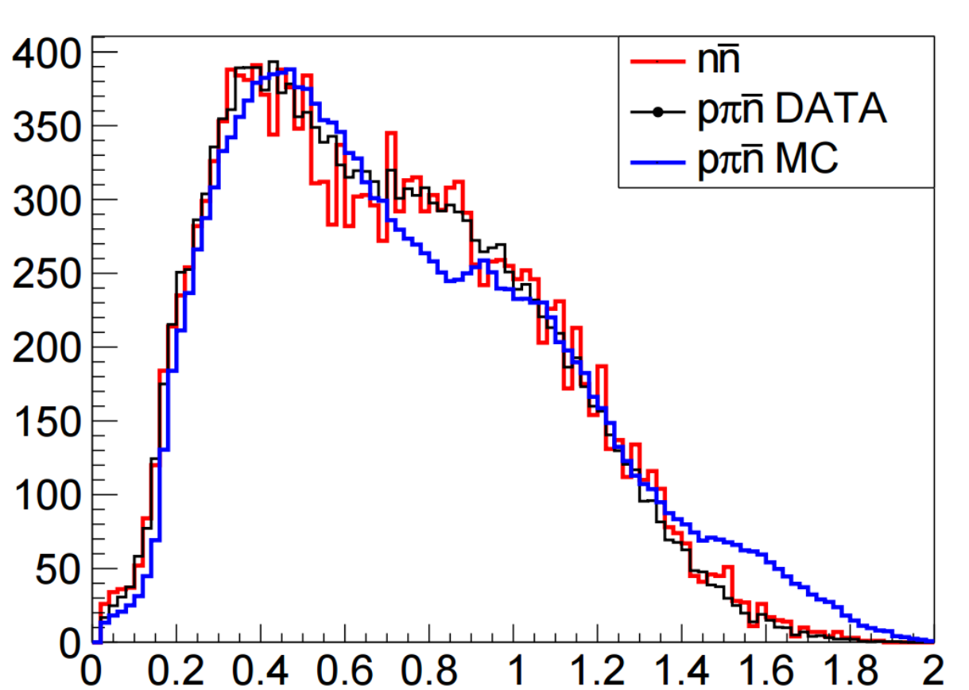
More Verification Needed
Energy Deposit of the leading shower

Slide 9
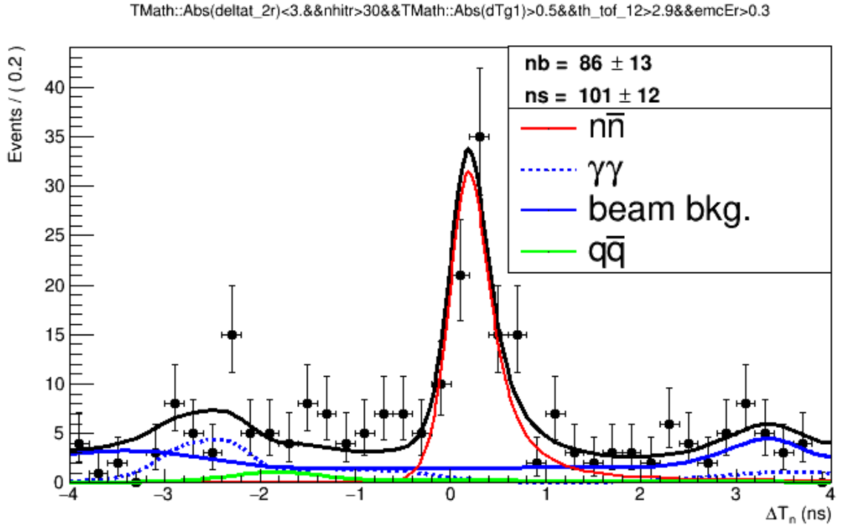
Fitting
(EMC+TOF) + (TOF)
including $e^{+}e^{−}→2γ$
excluding $e^{+}e^{−}→2γ$
Eff=1.39%, XS = 108 ± 12.4 (pb), significance = 8.2σ

Slide 10
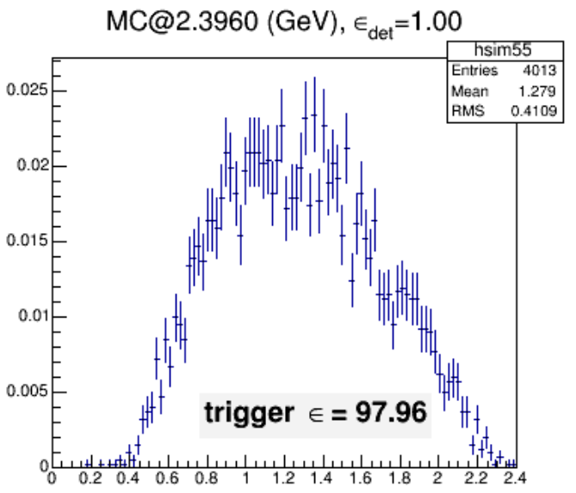
Correction of Trigger Efficiency
Trigger efficiency curve of the trigger channel: Nclus.GE.2 && Etot_M
Total Energy PDF of candidate events.
http://docbes3.ihep.ac.cn/DocDB/0000/000041/001/14.03-71267-iggerEfficiencyReport.pdf

Slide 11
Summary
Your comments are welcome.

