Slide 1
Measurement of $γ χ_{c0,1,2}→ Σ^{−}{\overline{Σ}}^{+}$ at BESIII
Irshad Muzaffar 勤奋
University of Science and Technology of China

Slide 2
Boss Version and Data Sample
Boss Version:
Boss 664p03
Data Sets:
Real Data 2012 , Run No. {-25388,0,-27090}
Use KKMC Event Generator for MC sample.
400M Inclusive Monte Carlo sample.
For Signal MC generated 1M Events.
Decay Chain :
$ψ\left(2S\right)→ γχ_{c0}$in P2GC0, For $χ_{c0}→ Σ^{−}\overline{Σ^{+}} in PHSP;$
$Σ^{−}→ {nπ}^{−}$ and $\overline{Σ^{+}}→ \overline{n}π^{+}$are in PHSP.

Slide 3
Event Selection
For Good Charged Track:
$\left|V_{z}\right|<30cm$, $\left|V_{r}\right|<10cm$and $|Cosθ|≤0.93$
$N_{Good }=2 and$Net charge for two charge tracks is zero.
For PID : dE/dX + TOF
${Prob}_{π }> {Prob}_{p },{Prob}_{π }> {Prob}_{k }{and N}_{π^{−}}=N_{π^{+} }$= 1
For Neutral Track:
$E_{barrel}>25MeV;E_{endcap}>50MeV$
$0≤TDC≤14(×50ns$)
At least 2 photons tracks Ngam>=2 (1 gamma, 1 for antineutron).
The most energetic shower consider as $\overline{n}$ candidate. $E_{\overline{n}}$> 0.2 GeV.
For Further Slection :
Do Kinematics fit 5C

Slide 4
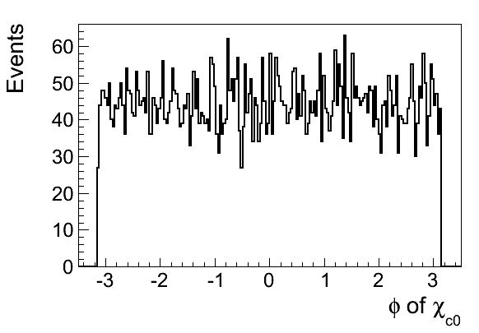
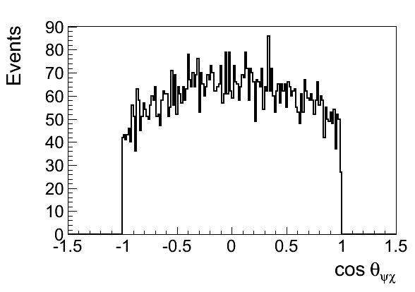
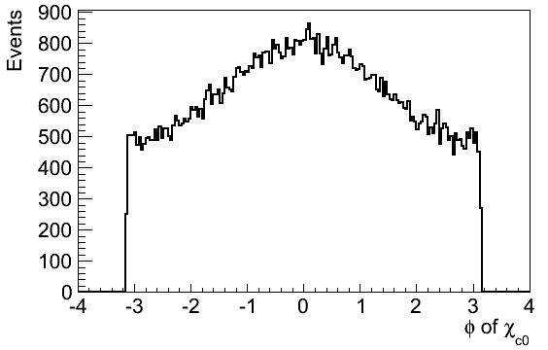
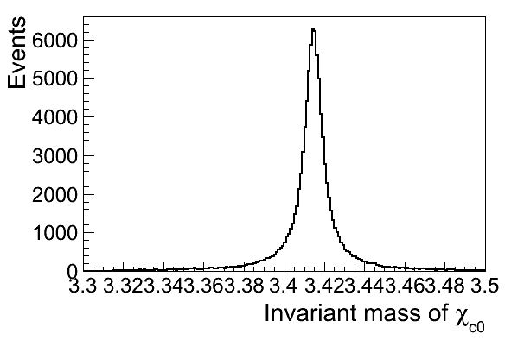
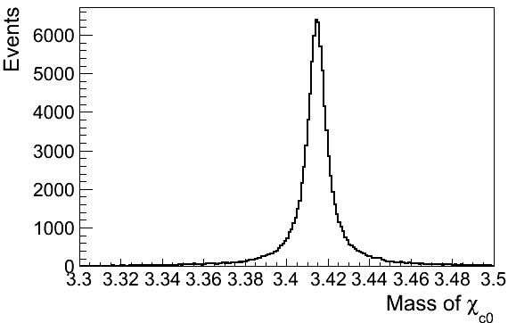
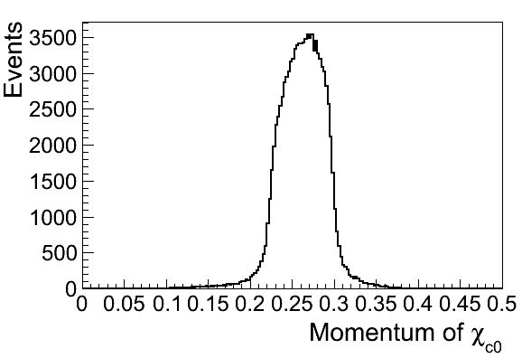
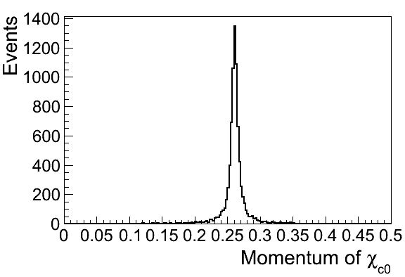
Mc Truth Information of Chic0

Slide 5
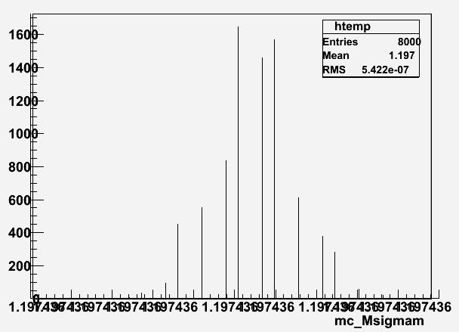
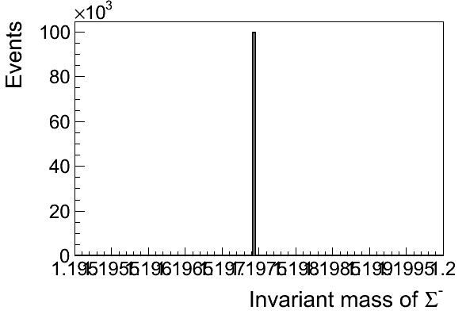
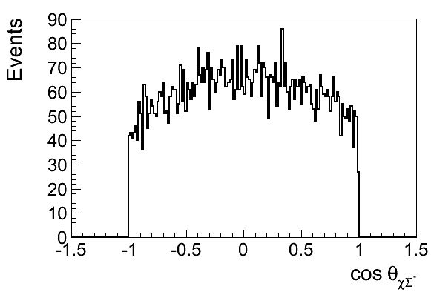
MC truth information of $Σ^{−}$

Slide 6
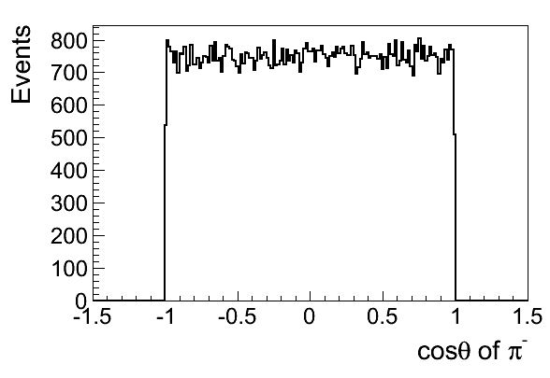
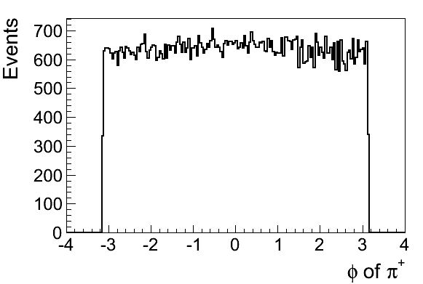
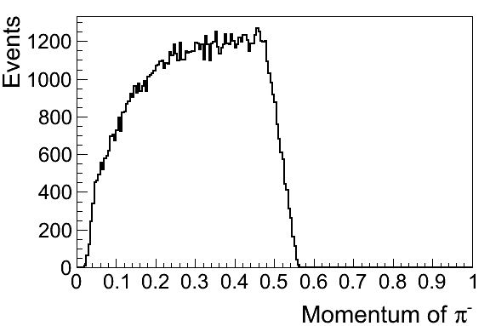
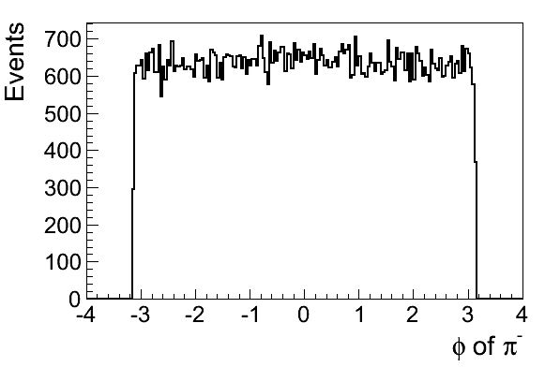
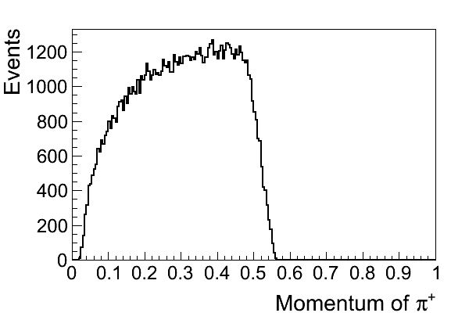
For pip and pim

Slide 7
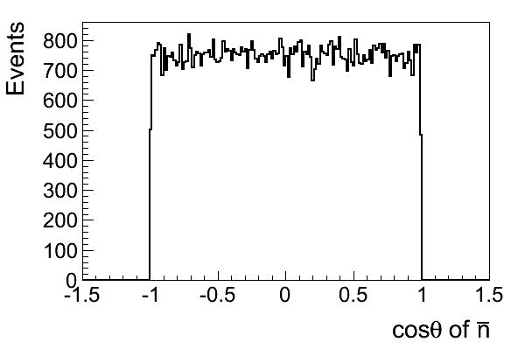
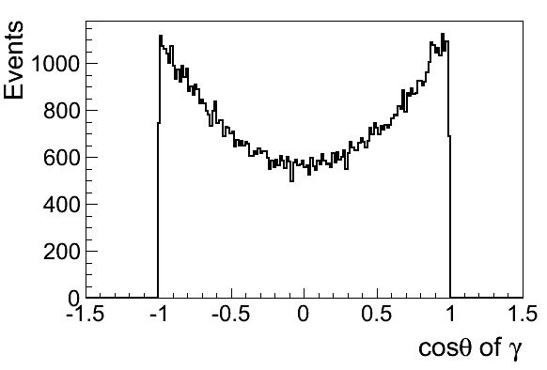
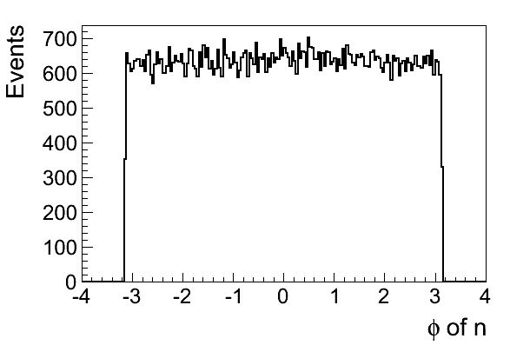
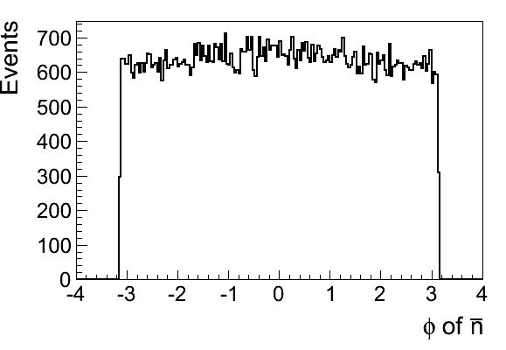
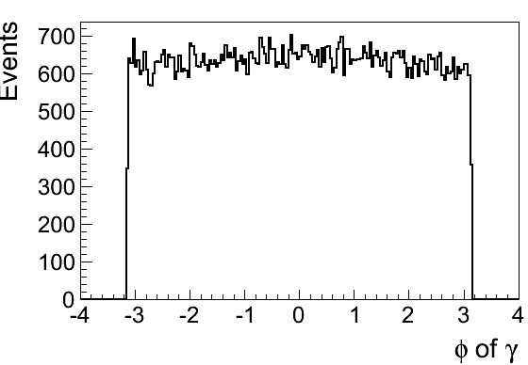
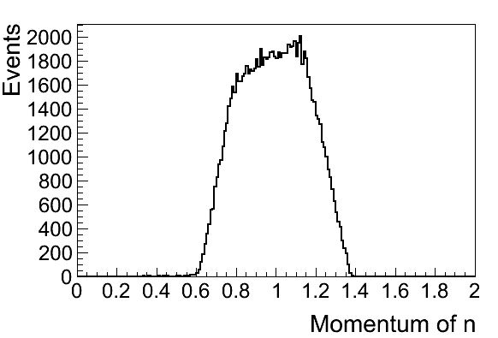
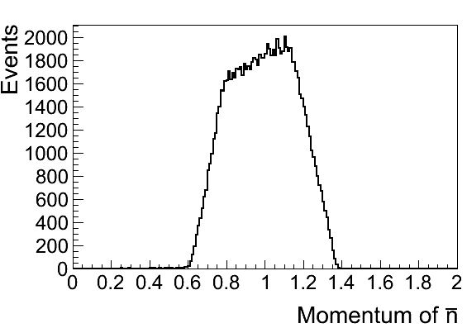
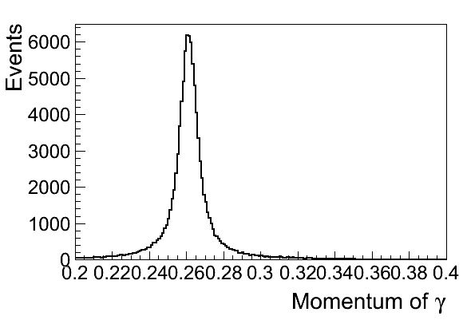
Distribution of Neutron, Anti-Neutron and Gamma

Slide 8
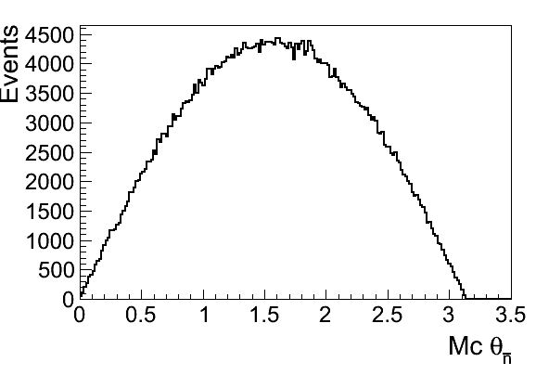
Theta Distribution of nbar

Slide 9
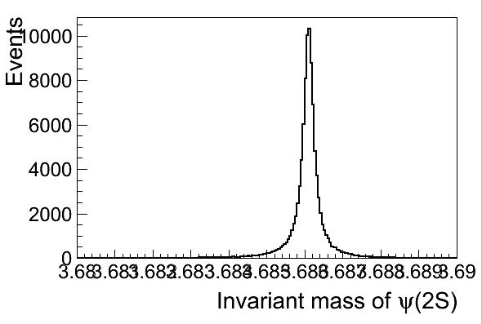
Invariant Mass of Psip,Chic0,and Sigmam

Slide 10
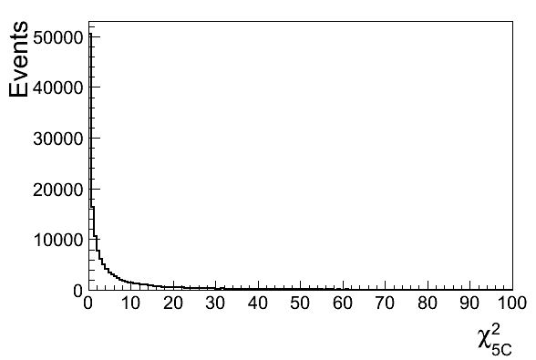
Chi-Square Distributions
After KM Fit1
After KM Fit2

Slide 11
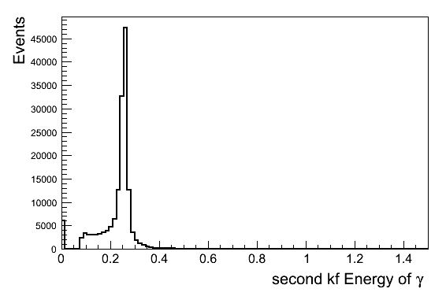
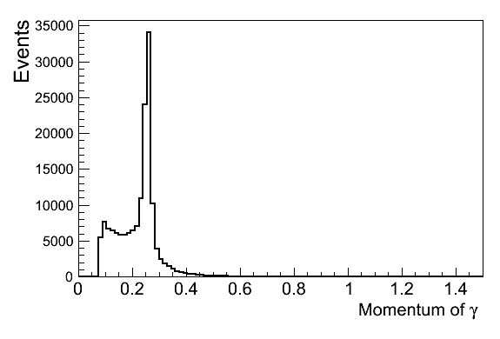
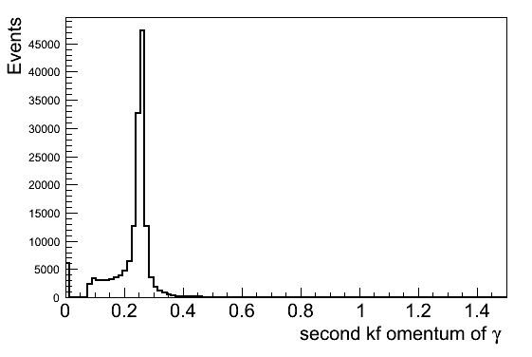
Momentum and Energy Distributions of Gamma after KM Fits 5C

Slide 12
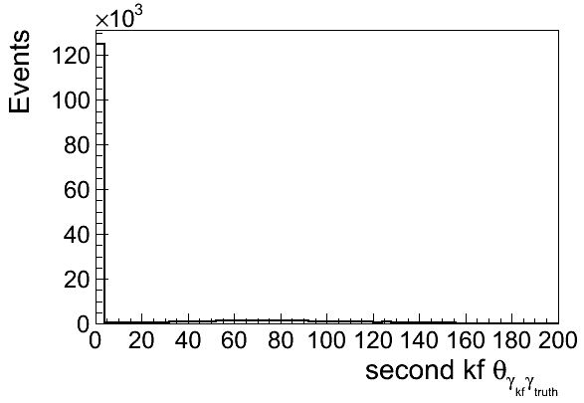
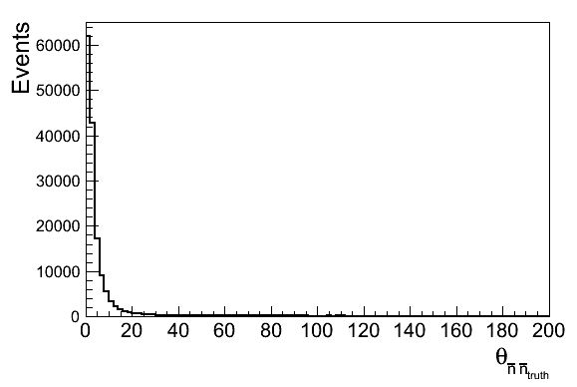
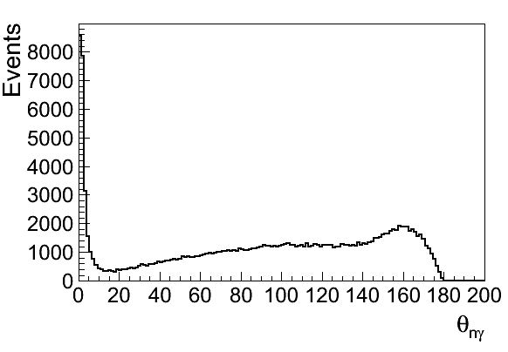
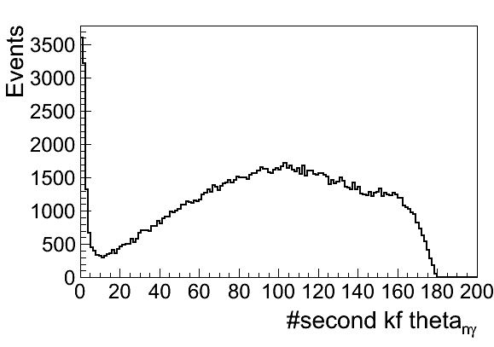
Matching Angle of Neutral tracks with MC Truth Information's

Slide 13
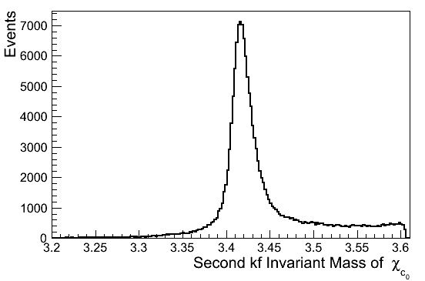
Invariant Mass of Chic0
KM Fit 1
KM Fit2

Slide 14
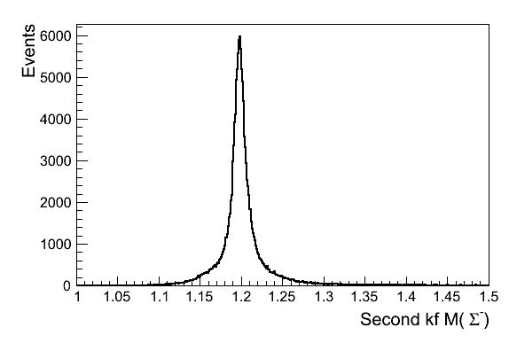
Invariant Mass of Sigma minus

